Slide 1
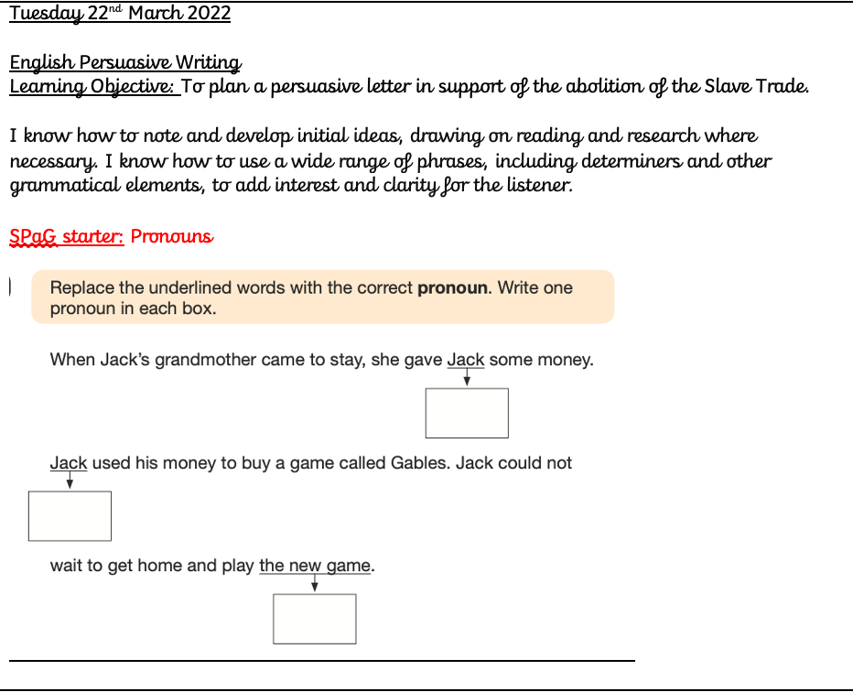

Slide 2
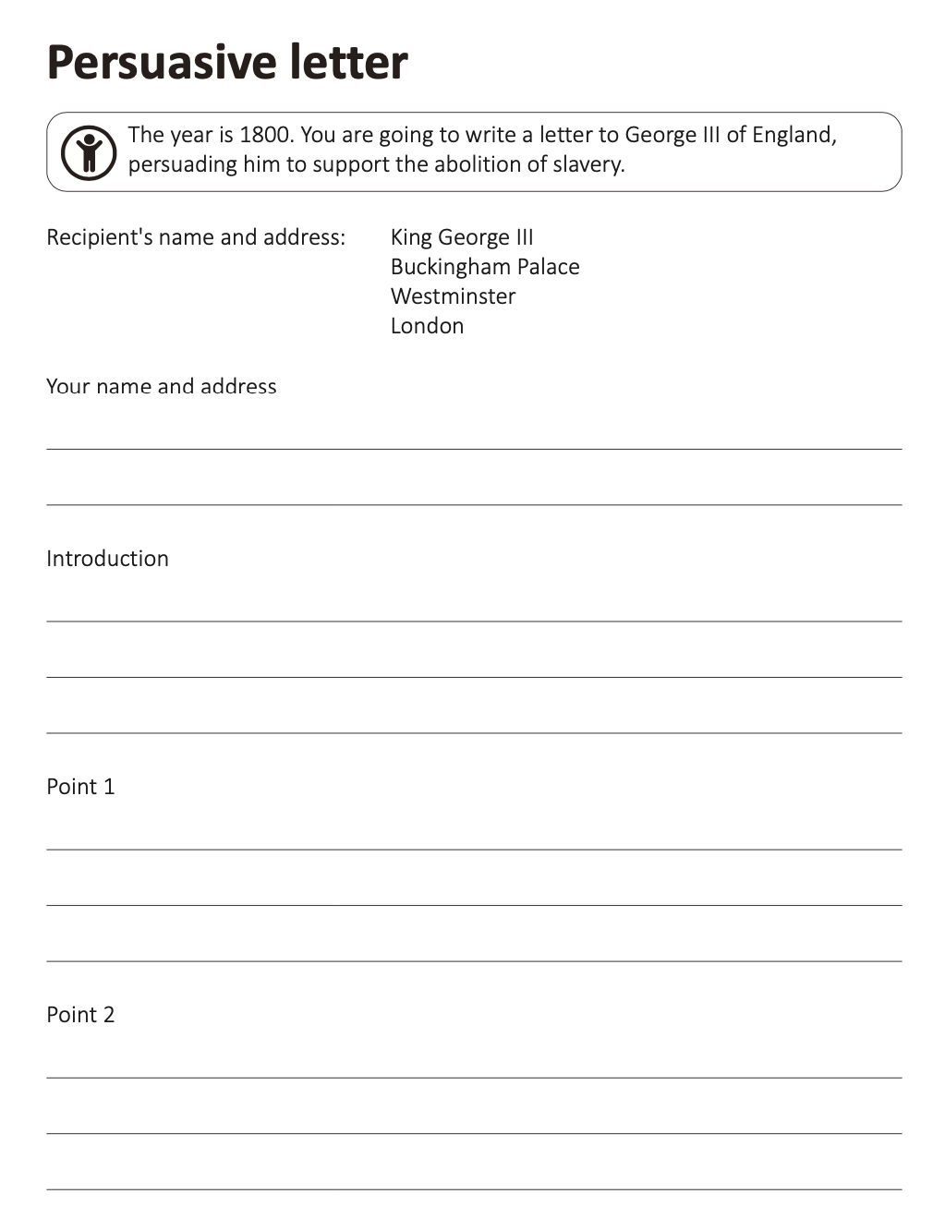


Slide 3
In the 15th century, people from European countries travelled to West Africa and bought enslaved people. Many of these enslaved people had been kidnapped or captured from across regions across West Africa, such as Senegambia. These enslaved people were then transported across the Atlantic Ocean and forced to work in the new colonies of the Caribbean and America.
It was also at this time Britain was beginning to build the British empire with colonies across the world. Britain joined the transatlantic slave trade in the 16th century.
It is thought from 1532 to 1832 over 12 million African people were enslaved and transported across the Atlantic Ocean. Britain was responsible for at least a third of these people who were taken from their homes across regions in Africa.
Manufactured goods, such as guns, cloth, pots and pans, were taken on ships from Britain heading for West Africa.

Slide 4
The manufactured goods were traded for enslaved people. Most enslaved people had been kidnapped from their homes and families, sometimes targeted because they were young or strong.
The enslaved people were transported in terrible conditions across the Atlantic Ocean. This stage was called the Middle Passage. When the ships arrived in America and the Caribbean, the enslaved people were sold and forced to work on huge farms called plantations.
It is thought over 2 million enslaved people died on this route.
The journey across the Atlantic Ocean depended on the weather. It could take from as little as six weeks up to several months. Enslaved people were chained up in the hold of the ship with their legs shackled to the person next to them.
The conditions onboard were horrific. The enslaved people were chained to the floor, having to eat where they were chained. Diseases, such as smallpox and measles, spread quickly amongst those onboard. At times, they were released to the open deck to be washed. People who died were simply thrown overboard. They were given no dignity.

Slide 5
When the exhausted enslaved people arrived in the colonies of America and the Caribbean, they were brought to a slave market close to the harbour. The owners of plantations would hurry to the markets, wanting to buy the strongest looking enslaved people for their plantations. The enslaved people would be sold to the highest bidder.
In 1700, an enslaved African would cost £3 worth of goods such as cloth, guns, gunpowder or brandy.
How do you feel about a person being traded like this for goods?
There were no rules at these markets. Families were not kept together, so children could be sold separately to their parents. Once sold, families never saw each other again.
Once the enslaved people were bought at these markets, they became the property of the owner. Often, once they were bought, they were branded with a hot iron to show who they belonged to.

Slide 6
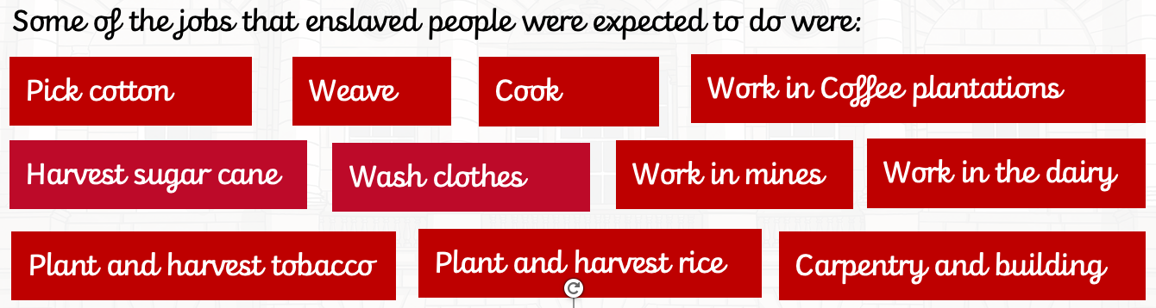
The owners of plantations used enslaved people to work on their land so they could grow crops as cheaply as possible. Enslaved people weren’t paid so the plantation owners made a bigger profit.
Enslaved people were treated poorly on the plantations. They worked extremely long hours with no breaks, were often hurt physically and were punished very severely if they made mistakes or worked slowly. If enslaved people tried to run away, they could be killed as a warning to others.

Slide 7
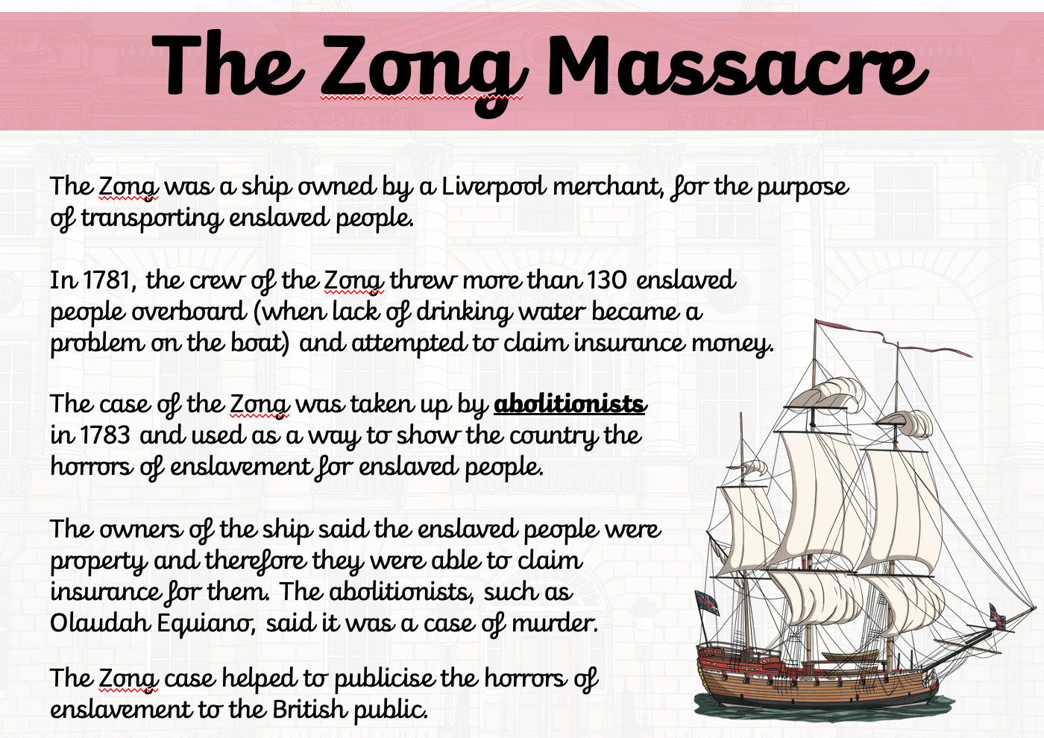

Slide 8
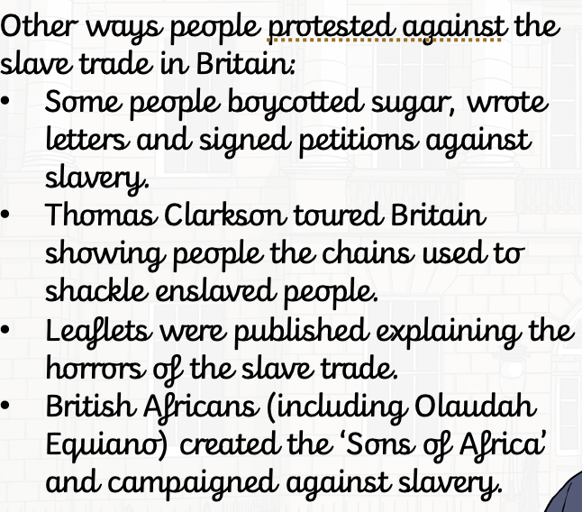
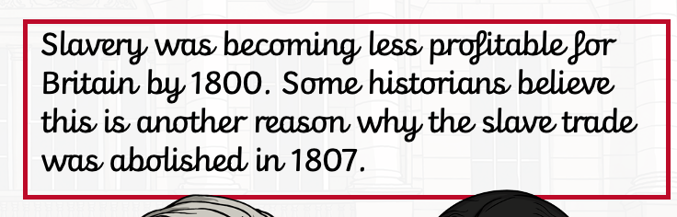
In 1787, the Committee for the Abolition of the Slave Trade was set up. William Wilberforce represented the committee in Parliament, arguing for an end to the slave trade. Wilberforce argued it was wrong to try and own a person like a piece of property.

