Slide 1



LIFE/work balance
We have started a #LIFEworkbalance campaign and we need your help to complete our LIFE/work balance survey.
We hope to publish the results soon, so please give 15 minutes of your time to help us get a true picture of school life.
Want to be a part of this campaign? Take the survey on our website and share it with your colleagues!
© Classroom Secrets Limited 2019

Slide 2
Year 4 – Autumn Block 4 – Multiplication and Division – Multiply and Divide by 9
About This Resource:
This PowerPoint has been designed to support your teaching of this small step. It includes a starter activity and an example of each question from the Varied Fluency and Reasoning and Problem Solving resources also provided in this pack. You can choose to work through all examples provided or a selection of them depending on the needs of your class.
National Curriculum Objectives:
Mathematics Year 4: (4N1) Count in multiples of 6, 7, 9, 25 and 1000
Mathematics Year 4: (4C6a) Recall multiplication and division facts for multiplication tables up to 12 × 12
Mathematics Year 4: (4C8) Solve problems involving multiplying and adding, including using the distributive law to multiply two digit numbers by one digit, integer scaling problems and harder correspondence problems such as n objects are connected to m objects
More Year 4 Multiplication and Division resources.
Did you like this resource? Don’t forget to review it on our website.
© Classroom Secrets Limited 2018

Slide 3
Year 4 – Autumn Block 4 – Multiplication and Division
Step 9: Multiply and Divide by 9
© Classroom Secrets Limited 2018

Slide 4
Introduction
Highlight all the multiples of 9 in the hundred square below.
What do you notice about the highlighted numbers?
1 | 2 | 3 | 4 | 5 | 6 | 7 | 8 | 9 | 10
11 | 12 | 13 | 14 | 15 | 16 | 17 | 18 | 19 | 20
21 | 22 | 23 | 24 | 25 | 26 | 27 | 28 | 29 | 30
31 | 32 | 33 | 34 | 35 | 36 | 37 | 38 | 39 | 40
41 | 42 | 43 | 44 | 45 | 46 | 47 | 48 | 49 | 50
51 | 52 | 53 | 54 | 55 | 56 | 57 | 58 | 59 | 60
61 | 62 | 63 | 64 | 65 | 66 | 67 | 68 | 69 | 70
71 | 72 | 73 | 74 | 75 | 76 | 77 | 78 | 79 | 80
81 | 82 | 83 | 84 | 85 | 86 | 87 | 88 | 89 | 90
91 | 92 | 93 | 94 | 95 | 96 | 97 | 98 | 99 | 100
© Classroom Secrets Limited 2018

Slide 5
Introduction
Highlight all the multiples of 9 in the hundred square below.
What do you notice about the highlighted numbers?
1 | 2 | 3 | 4 | 5 | 6 | 7 | 8 | 9 | 10
11 | 12 | 13 | 14 | 15 | 16 | 17 | 18 | 19 | 20
21 | 22 | 23 | 24 | 25 | 26 | 27 | 28 | 29 | 30
31 | 32 | 33 | 34 | 35 | 36 | 37 | 38 | 39 | 40
41 | 42 | 43 | 44 | 45 | 46 | 47 | 48 | 49 | 50
51 | 52 | 53 | 54 | 55 | 56 | 57 | 58 | 59 | 60
61 | 62 | 63 | 64 | 65 | 66 | 67 | 68 | 69 | 70
71 | 72 | 73 | 74 | 75 | 76 | 77 | 78 | 79 | 80
81 | 82 | 83 | 84 | 85 | 86 | 87 | 88 | 89 | 90
91 | 92 | 93 | 94 | 95 | 96 | 97 | 98 | 99 | 100
© Classroom Secrets Limited 2018

Slide 6
Varied Fluency 1
Write a multiplication and division calculation based on the bar model.
63
7 | 7 | 7 | 7 | 7 | 7 | 7 | 7 | 7
 | ÷ |  | =
 | x |  | =
© Classroom Secrets Limited 2018

Slide 7
Varied Fluency 1
Write a multiplication and division calculation based on the bar model.
63
7 | 7 | 7 | 7 | 7 | 7 | 7 | 7 | 7
63 | ÷ | 9 | = | 7
7 | x | 9 | = | 63
© Classroom Secrets Limited 2018

Slide 8
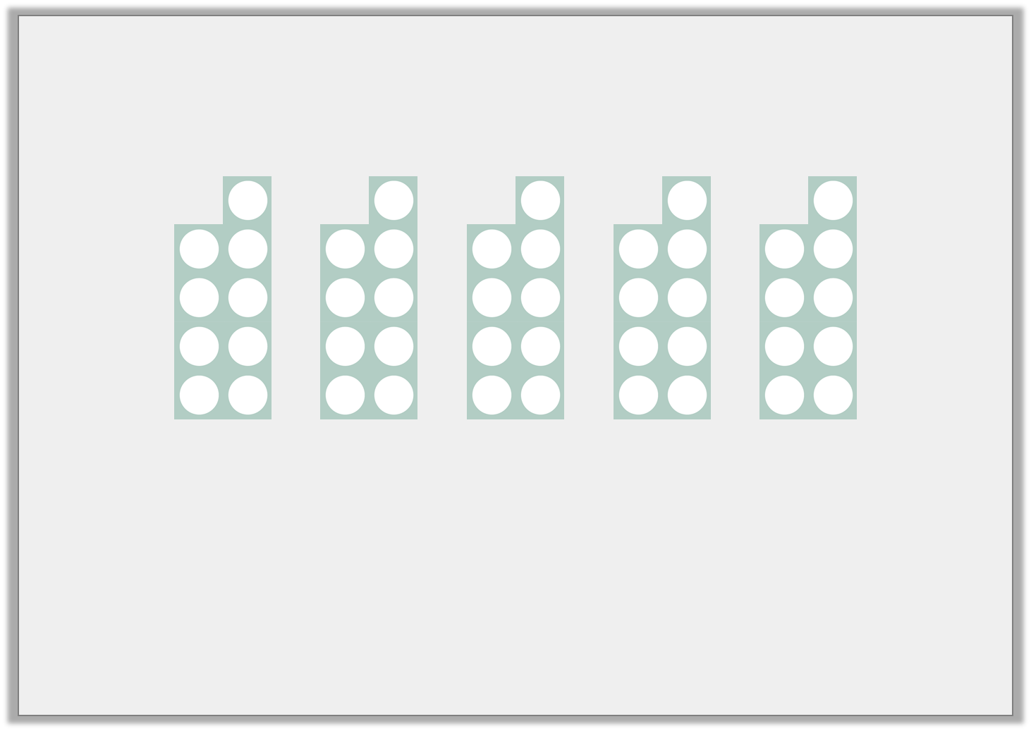
Varied Fluency 2
Using the image below, complete the number sentences.
45 | ÷ |  | =
 | ÷ | 9 | =
 | x | 9 | =
 | x |  | = | 45
© Classroom Secrets Limited 2018

Slide 9
Varied Fluency 2
Using the image below, complete the number sentences.
45 | ÷ | 5 | = | 9
45 | ÷ | 9 | = | 5
5 | x | 9 | = | 45
9 | x | 5 | = | 45
© Classroom Secrets Limited 2018

Slide 10
Varied Fluency 3
Circle the number sentences that are represented by the array.
3 | x | 9 | = | 27
27 | ÷ | 9 | = | 3
9 | x | 3 | = | 27
28 | ÷ | 8 | = | 3
© Classroom Secrets Limited 2018

Slide 11
Varied Fluency 3
Circle the number sentences that are represented by the array.
3 | x | 9 | = | 27
27 | ÷ | 9 | = | 3
9 | x | 3 | = | 27
28 | ÷ | 8 | = | 3
© Classroom Secrets Limited 2018

Slide 12
Varied Fluency 4
Use the sentences to complete the calculations.
There are six 9s.
There are 11 lots of 9.
 | x |  | =
 | x |  | =
© Classroom Secrets Limited 2018

Slide 13
Varied Fluency 4
Use the sentences to complete the calculations.
There are six 9s.
There are 11 lots of 9.
6 | x | 9 | = | 54
11 | x | 9 | = | 99
© Classroom Secrets Limited 2018

Slide 14
Problem Solving 1
Junior is making an array with counters to represent the calculation 4 x 9 = 36.
He adds some counters to show how he would calculate 6 x 9.
Find and correct his mistake.
© Classroom Secrets Limited 2018

Slide 15
Problem Solving 1
Junior is making an array with counters to represent the calculation 4 x 9 = 36.
He adds some counters to show how he would calculate 6 x 9.
Find and correct his mistake.
Junior has added 2 columns of 4 counters which represents 11 x 4. He should have added 2 more rows of 9 counters to find the correct answer of 54.
© Classroom Secrets Limited 2018

Slide 16
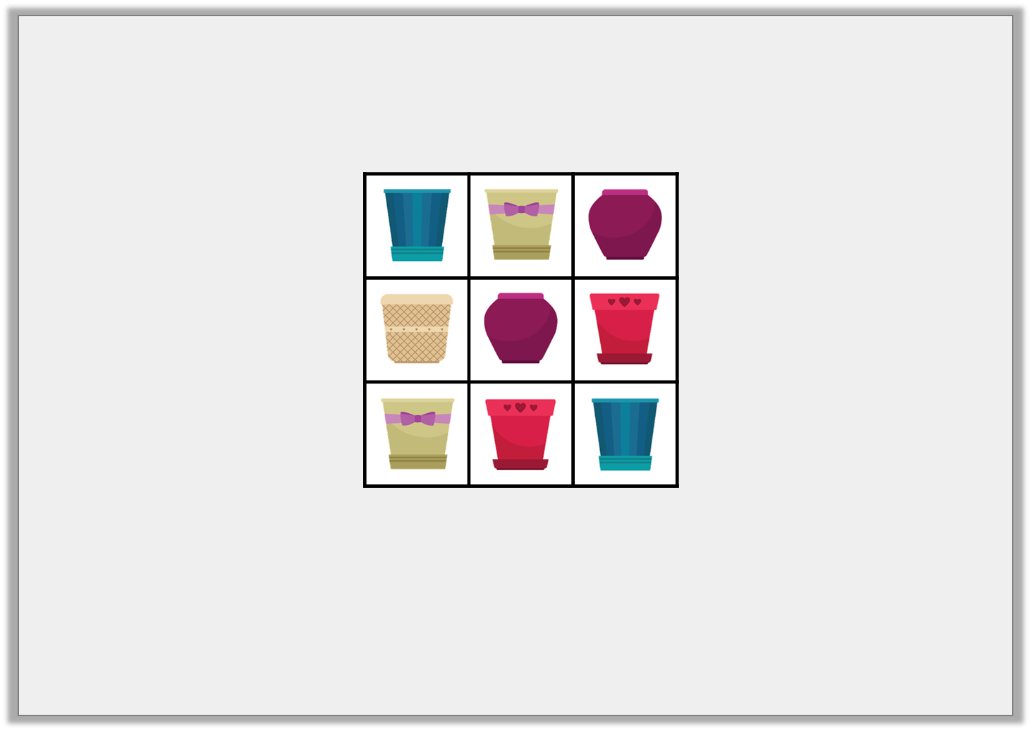
Reasoning 1
Ameerah is packing plant pots in boxes. She can put 9 pots in each box and each box is full.
Ameerah has between 20 and 40 plant pots.
How many boxes might she need?
© Classroom Secrets Limited 2018

Slide 17
Reasoning 1
Ameerah is packing plant pots in boxes. She can put 9 pots in each box and each box is full.
Ameerah has between 20 and 40 plant pots.
How many boxes might she need?
Ameerah could have 27 or 36 plant pots so…
© Classroom Secrets Limited 2018

Slide 18
Reasoning 1
Ameerah is packing plant pots in boxes. She can put 9 pots in each box and each box is full.
Ameerah has between 20 and 40 plant pots.
How many boxes might she need?
Ameerah could have 27 or 36 plant pots so she might need 3 (27 ÷ 9 = 3) or 4 (36 ÷ 9 = 4) boxes.
© Classroom Secrets Limited 2018

Slide 19

Reasoning 2
Riley and Anoop are comparing how many books they each have. There are 9 books on each shelf.
Riley says,
Is he correct? Prove it.
Anoop has more books than me because she has 7 full shelves. I have 81 books.
© Classroom Secrets Limited 2018

Slide 20
Reasoning 2
Riley and Anoop are comparing how many books they each have. There are 9 books on each shelf.
Riley says,
Is he correct? Prove it.
Riley is incorrect because…
Anoop has more books than me because she has 7 full shelves. I have 81 books.
© Classroom Secrets Limited 2018

Slide 21
Reasoning 2
Riley and Anoop are comparing how many books they each have. There are 9 books on each shelf.
Riley says,
Is he correct? Prove it.
Riley is incorrect because Anoop has 7 x 9 = 63 books. 81 is more than 63, so Riley has more.
Anoop has more books than me because she has 7 full shelves. I have 81 books.
© Classroom Secrets Limited 2018

