Slide 2
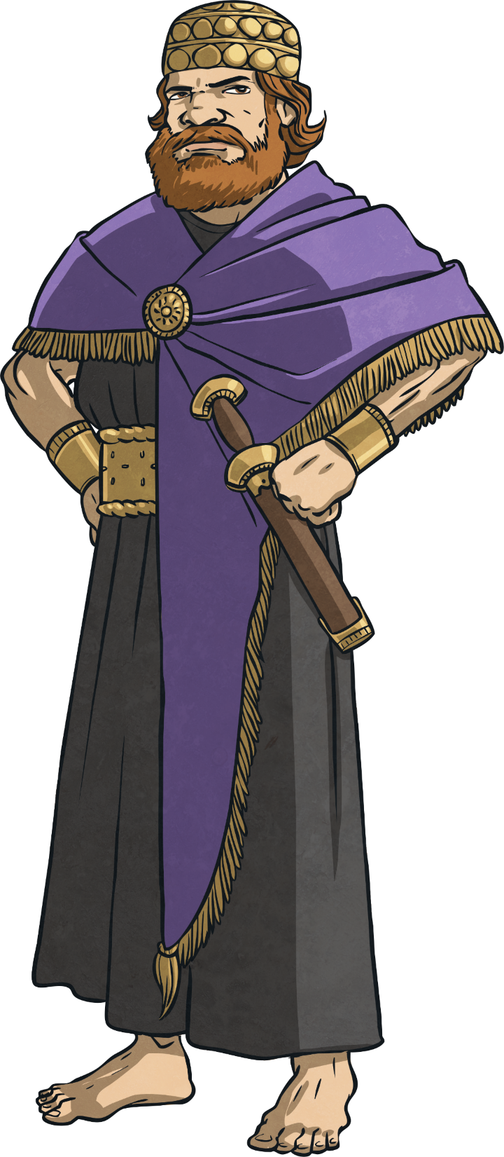
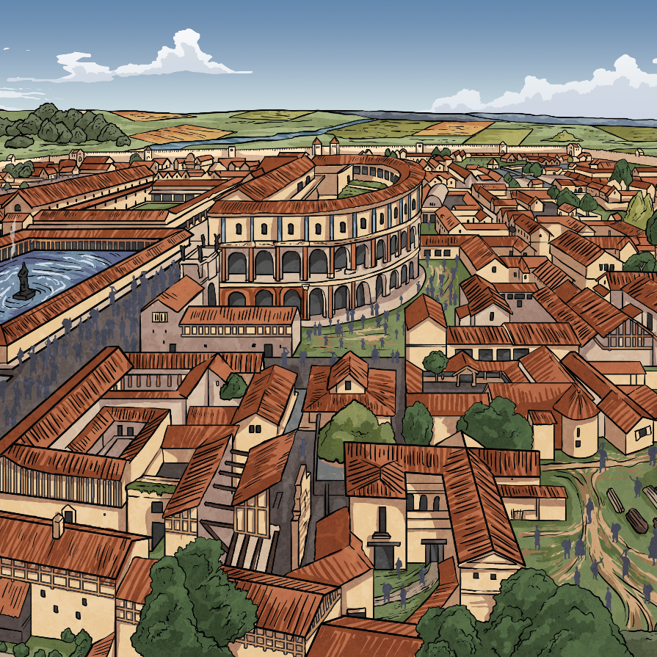
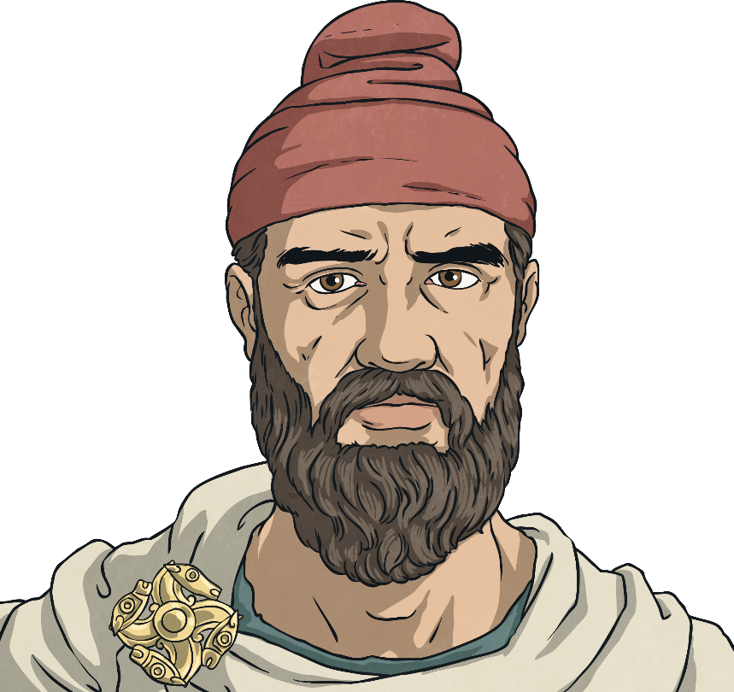
Romulus and Remus
Long ago, before Christianity, in the fine city of Alba Longa, Italy, lived King Numitor.
All was not well in Alba Longa because the
younger brother of King Numitor, Amulius,
wanted the throne for himself and he
eventually took it.
I am King Amulius and I took the throne from my brother. No one will take my throne from me!
I am King Numitor and I know that my brother is going to take my throne from me because he wants to rule my kingdom.

Slide 3

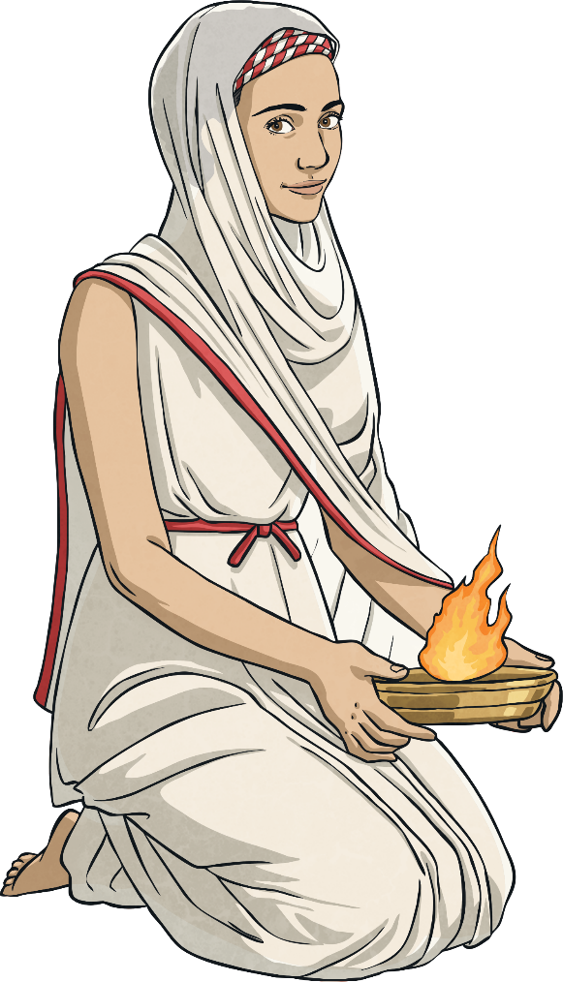
Romulus and Remus
Amulius was adamant that no one should threaten his new position so, just to make sure, he had Numitor’s sons killed. He made Numitor’s only daughter, Rhea Silvia, become a Priestess of Vesta which meant she was not allowed to marry or have children. Now, Amulius would no longer have to worry that she might have a son who would one day threaten his throne.
I am Numitor’s only daughter and Amulius is worried that if I have children, they would take the throne from him, so he does not want me to have children.

Slide 4


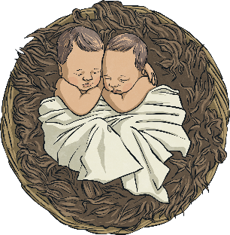
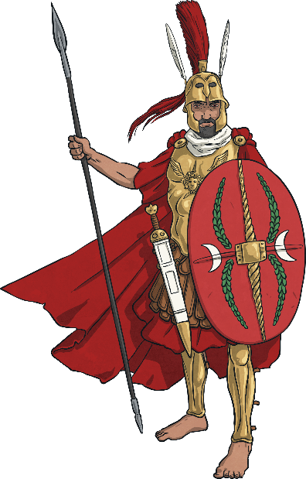
Romulus and Remus
However, the plan backfired, as Rhea Silvia fell in love with Mars, the Roman God of War, and they had twin sons. Usually, the punishment for going against the rules of the Priestesses of Vesta was death but Mars was a hugely powerful man and Amulius feared him. So instead, he imprisoned Rhea Silvia and ordered a servant to take the twins and put them in the River Tiber.
These are our sons but Amulius does not want them around as he is threatened by them.
I am Mars, the God of War. Amulius fears me so he will not have Rhea killed.

Slide 5
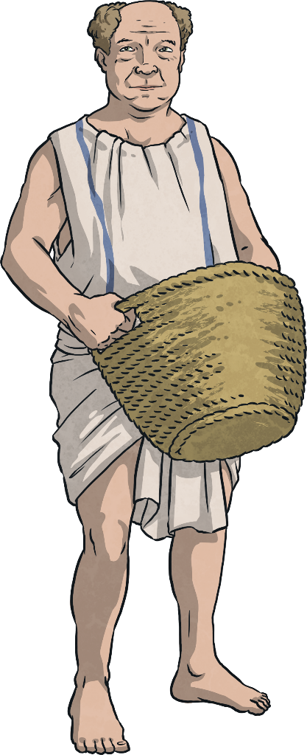
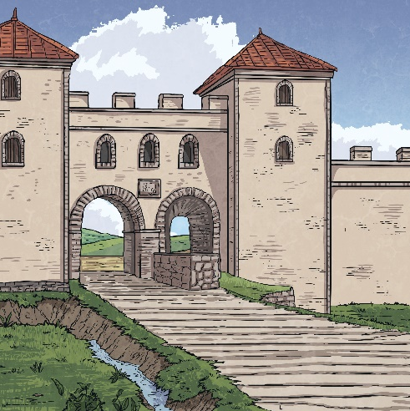
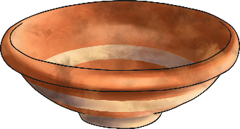
Romulus and Remus
Unbeknown to Amulius, when the servant arrived at the river, he could not bring himself to throw them in so he left them in their basket and let them float downstream where he hoped they would be rescued.
Amulius has sent me to get rid of the boys but I am going to put them safely in a basket and hope that someone kind will find them and look after them.

Slide 6
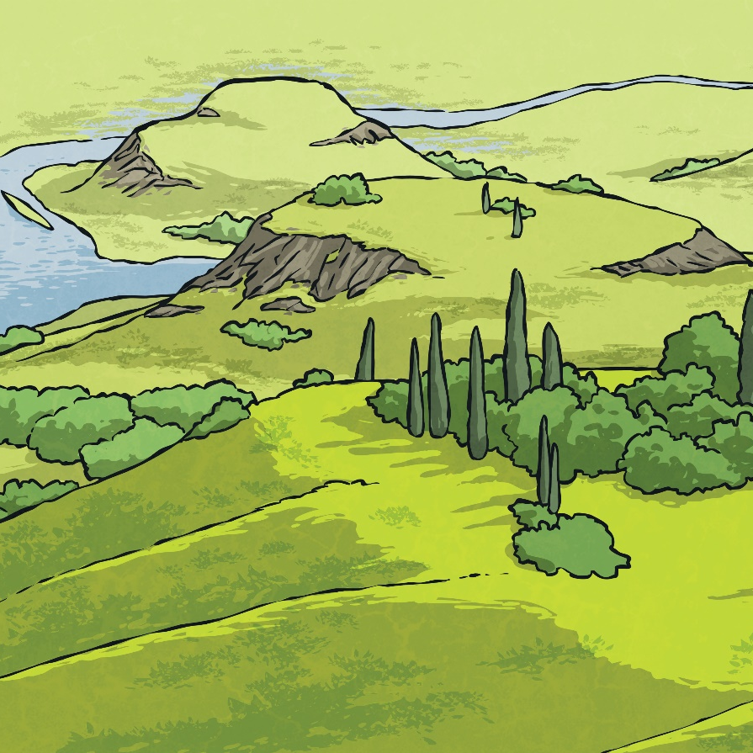
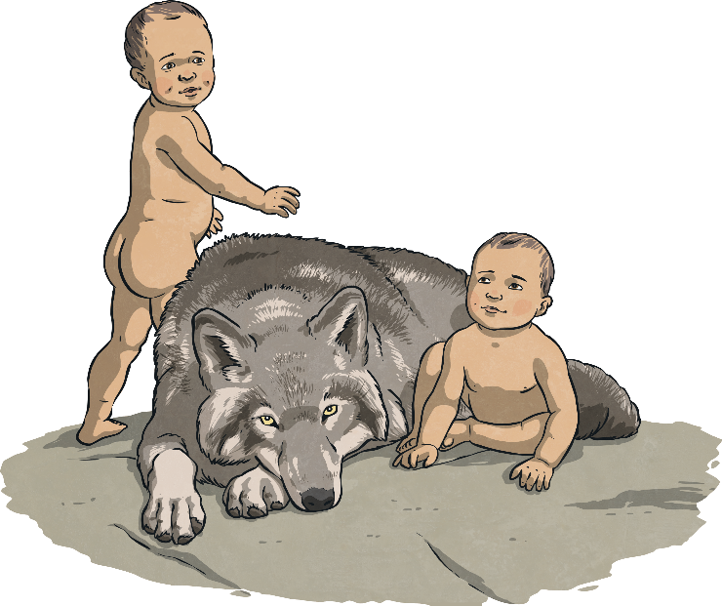
Romulus and Remus
Good fortune was on the side of the twins as a she-wolf found them and pulled them to safety. She protected and cared for them while
a friendly woodpecker helped them find food.
Even though they are humans, I will
care for these boys.

Slide 7

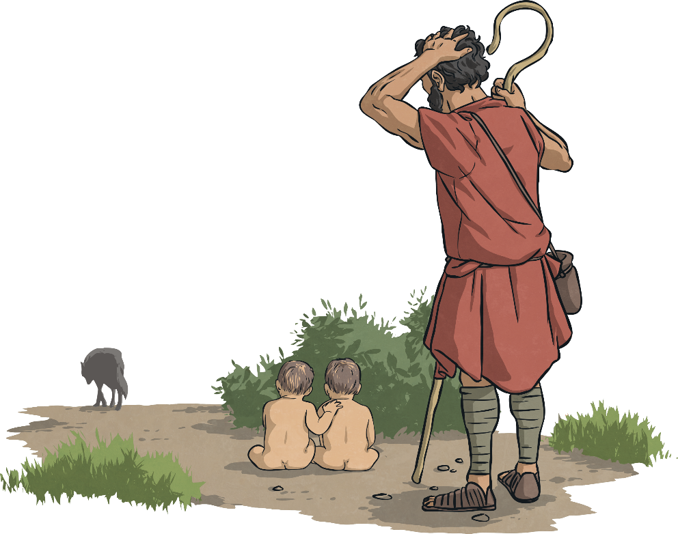
Romulus and Remus
The animals looked after the twins until a passing shepherd found them and took them home to be cared for by himself and his wife. They named the boys Romulus and Remus. The shepherd and his wife loved and brought up the two boys as their own. Both became shepherds like their father.
These two boys are all alone and have no one looking after them. I will take them home where my wife and I will love and care for them.

Slide 8
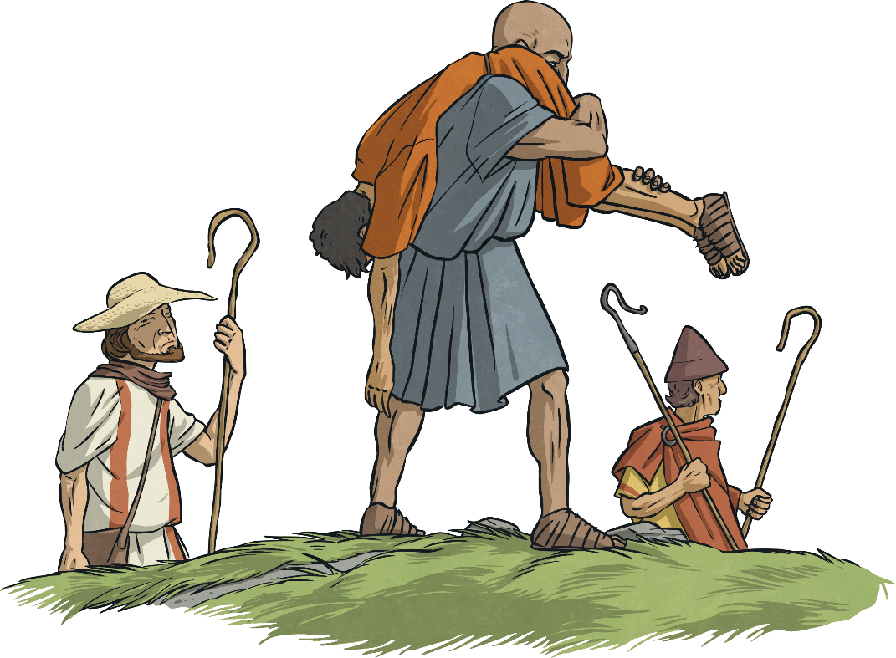
Romulus and Remus
One day, while the boys were with their sheep, they came across some shepherds of King Amulius and they ended up fighting. Remus was captured and taken back to King Amulius who did not recognise him as he believed the boys had died a long time ago.
You will be taken straight to King Amulius!
The other one’s escaped!

Slide 9
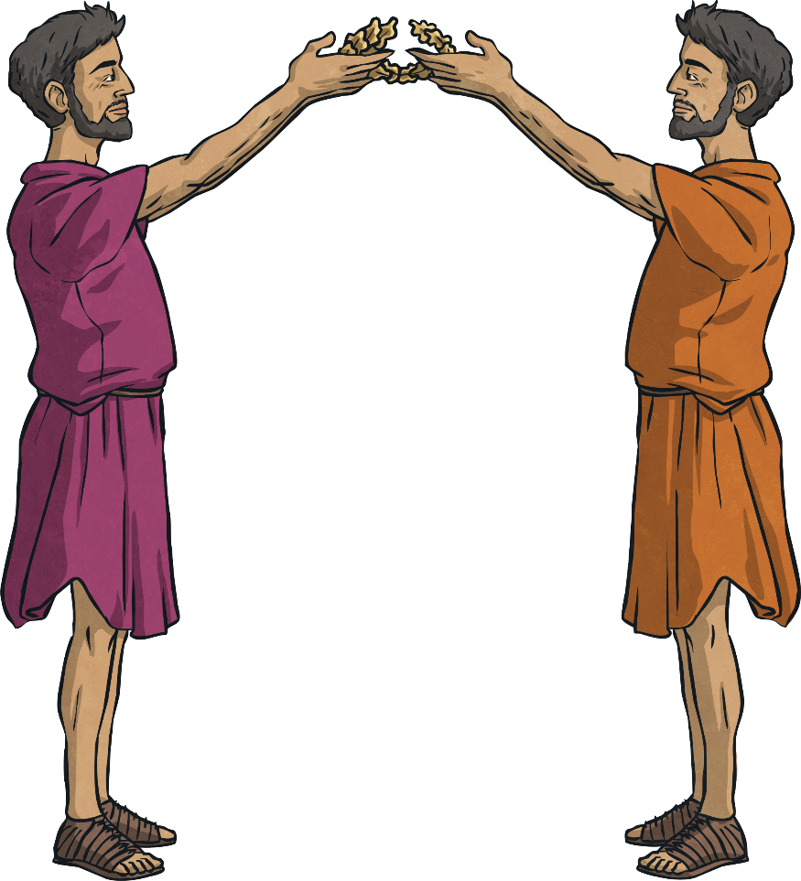
Romulus and Remus
Meanwhile, Romulus gathered a group
of shepherds to go and rescue Remus. Eventually, Romulus managed to free Remus but in the process killed King Amulius.
You’d have thought that the city people would be angry with the two boys but they found out their real identities and offered to crown them as joint rulers.
The King is dead, Romulus and Remus
are the rightful heirs to the throne.
They should share the throne.

Slide 10
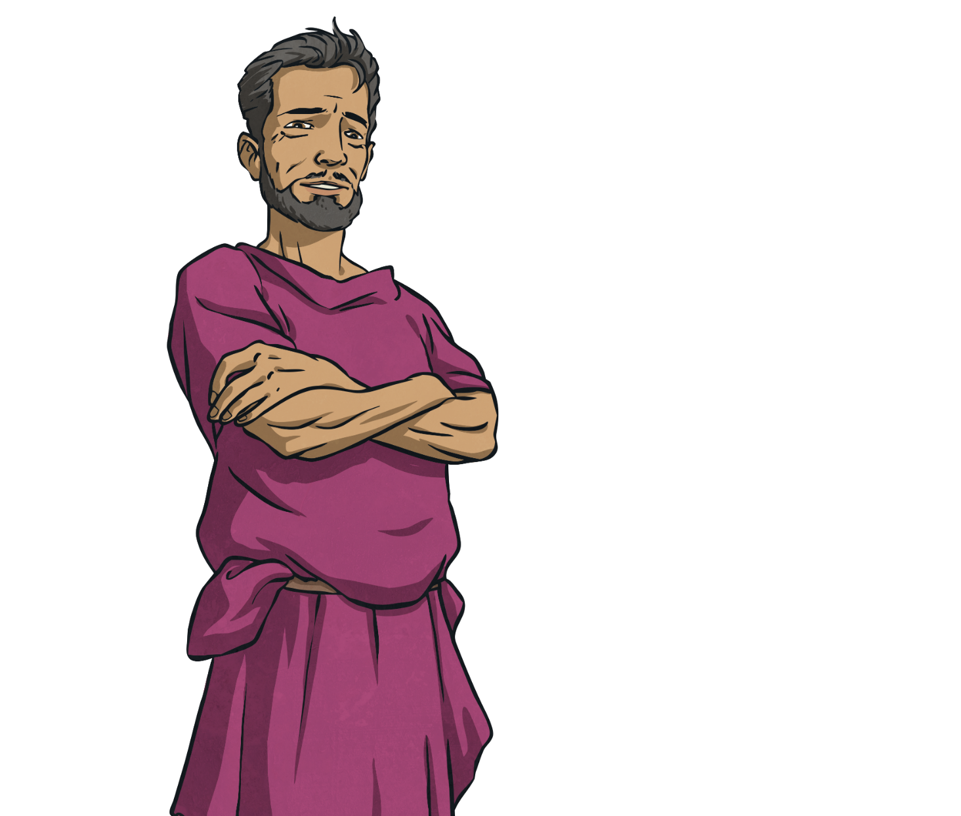
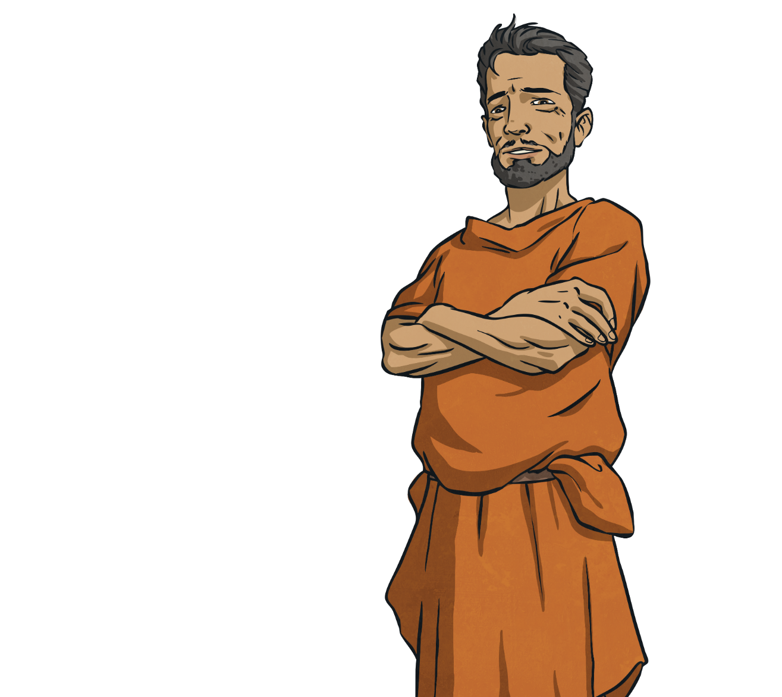
Romulus and Remus
Surprisingly, the boys turned down the offer as they wanted to build their own city. They finally found the place they wanted as their city – where Rome stands to this day. However, it wasn’t plain sailing as the two boys disagreed on which hill the city should be built. Romulus favoured Palatine Hill whereas Remus preferred Aventine Hill.
That would be nice, but we want to build our own city. We are going to look for somewhere to do it.
I think Aventine Hill would be perfect.
No, definitely Palatine Hill would be best.

Slide 11
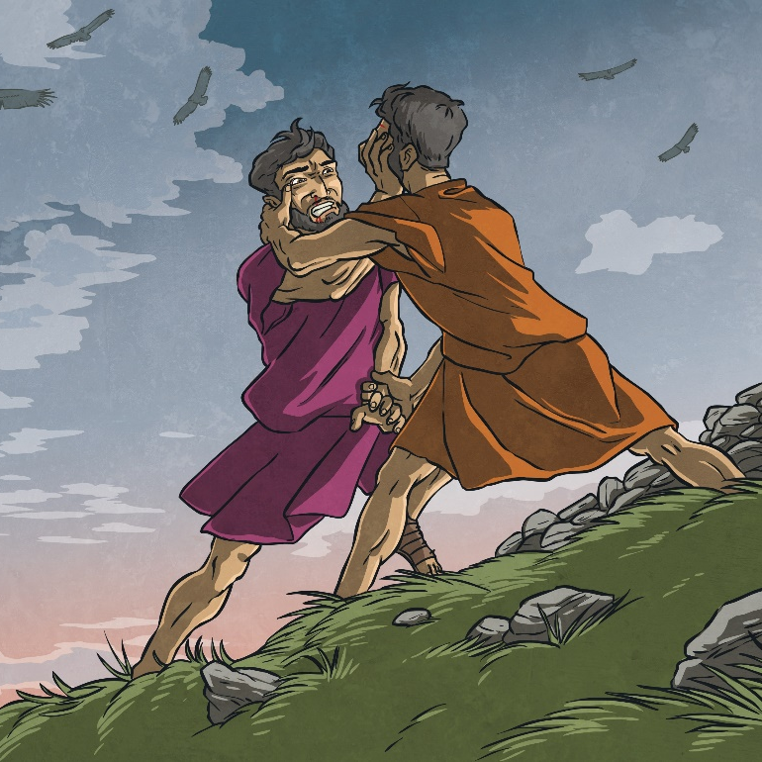
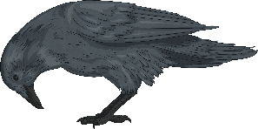
Romulus and Remus
The brothers decided to wait for a sign from the God Augury to tell them where to build. The sign came in the shape of a number of vultures although Romulus saw six and Remus saw twelve so each brother thought they had won. Not managing to see eye-to-eye, Romulus went on to build a wall around Palatine Hill. Remus was jealous and taunted his brother. They ended up in a
fight and Remus was killed
by Romulus.
The vultures are a sign that it should be
Palatine Hill and I have built a wall around it.
The vultures are a sign that it should be Aventine Hill you shouldn’t have built that wall!

Slide 12
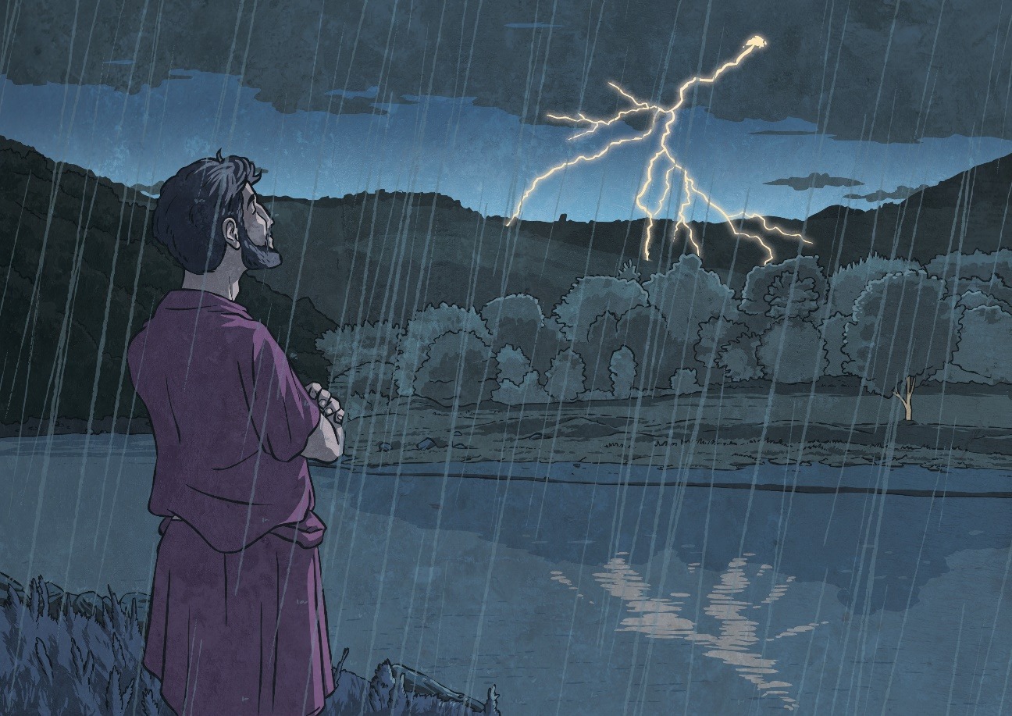
Romulus and Remus
Romulus, being alone, was now free to build his city as he wished. The city was finished on the 21st April 753 BC and Romulus made himself King and named the city ‘Rome’ from his own name.
My brother is gone and now I am free to
build my own city which I will name after
me and call ‘Rome’.

Slide 13

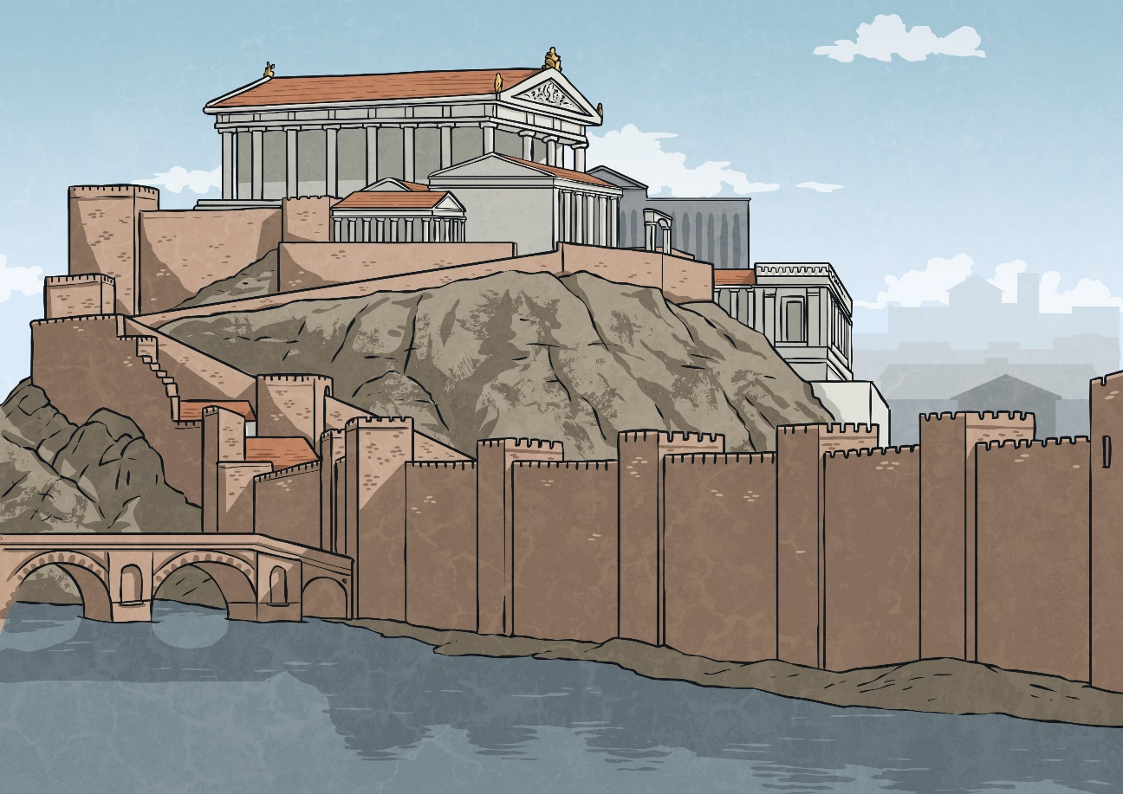
Romulus and Remus
Romulus then began to organise his city. He divided his army into legions of 3,300 men. He called his 100 most noble men the Patricians and the
elders of Rome the Senate. The city grew and prospered into one of the most powerful cities in the world and this would continue for
another 1,000 years.
I will create a senate, with the 100 most
noble men, to rule the city and I will split
my army into legions.

