Slide 1
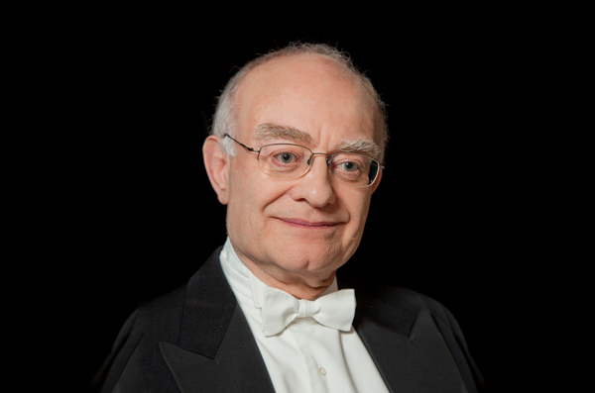
John Rutter
Composer of the Month – December 2020

Slide 2
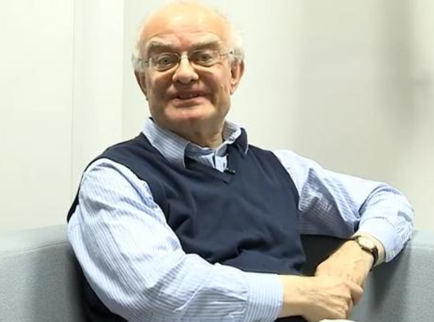
Who is John Rutter?
John Rutter is an English composer and conductor, associated mainly with choral music who was born in 1945.
His larger choral works, Gloria, Requiem, Magnificat, Mass of the Children, The Gift of Life, and Visions, are widely performed around the world, and many of his shorter pieces such as The Lord bless you and keep you, For the beauty of the earth, This is the day and All things bright and beautiful have become very popular songs for choirs.

Slide 3
How did John’s interest in music begin?
“I’ve known I wanted to be a musician ever since I could walk and talk, and the story is true that I first discovered music at home when I lifted the lid of the old upright piano in my parents’ London apartment and started to prod the keys, while at nursery school I sang along loudly with all the other kids at morning assembly each day. My bewildered parents, probably driven crazy by the hours of piano improvisation and piping treble singing they endured, thought that if you can’t stop it at least get him to do it better, so they sent me at age seven for piano lessons.”
John Rutter

Slide 4
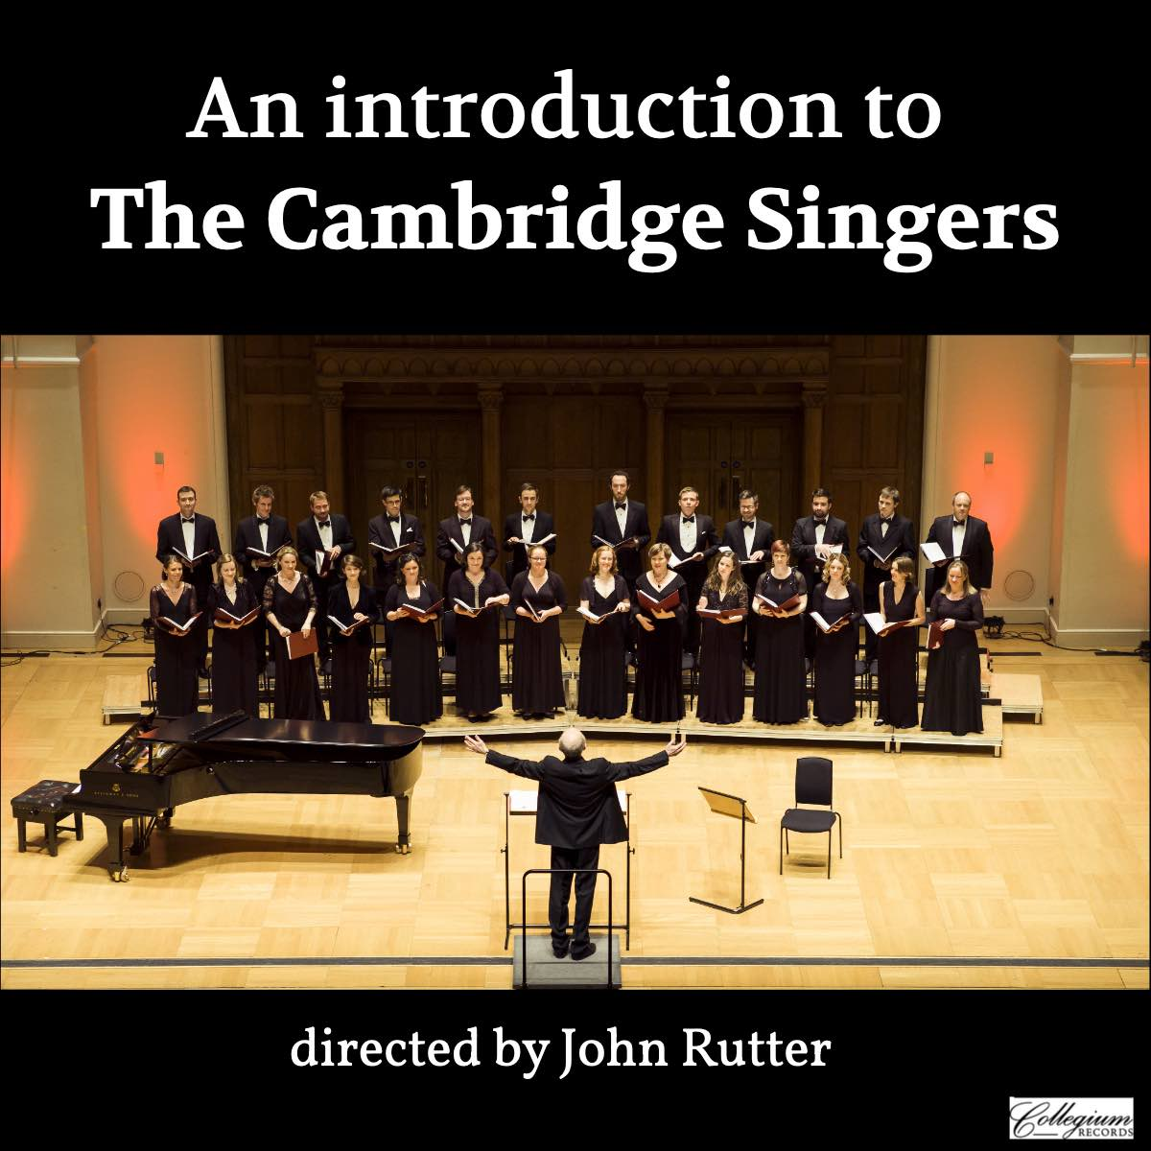
The Cambridge Singers
In 1981, Rutter founded his own choir, the Cambridge Singers, which he conducts and with which he has made many recordings of sacred choral repertoire (including his own works), particularly under his own label Collegium Records. He lives in Hemingford Abbots in Cambridgeshire and frequently conducts many choirs and orchestras around the world.

Slide 5
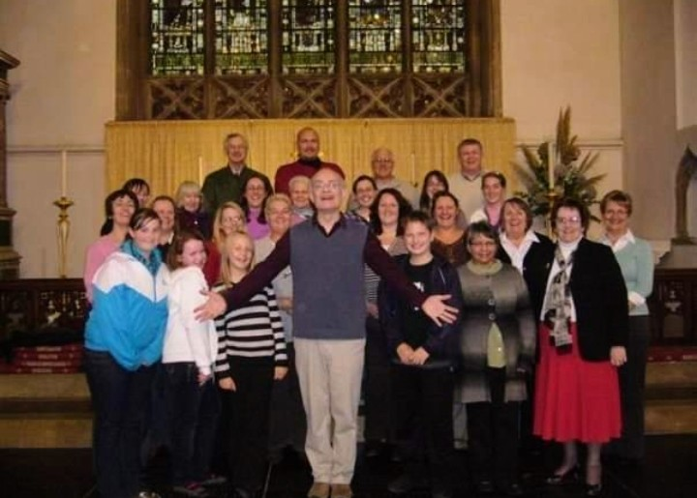
Mrs Jeffery has met and sung with him!!!
Can you find her in this photo?

Slide 6
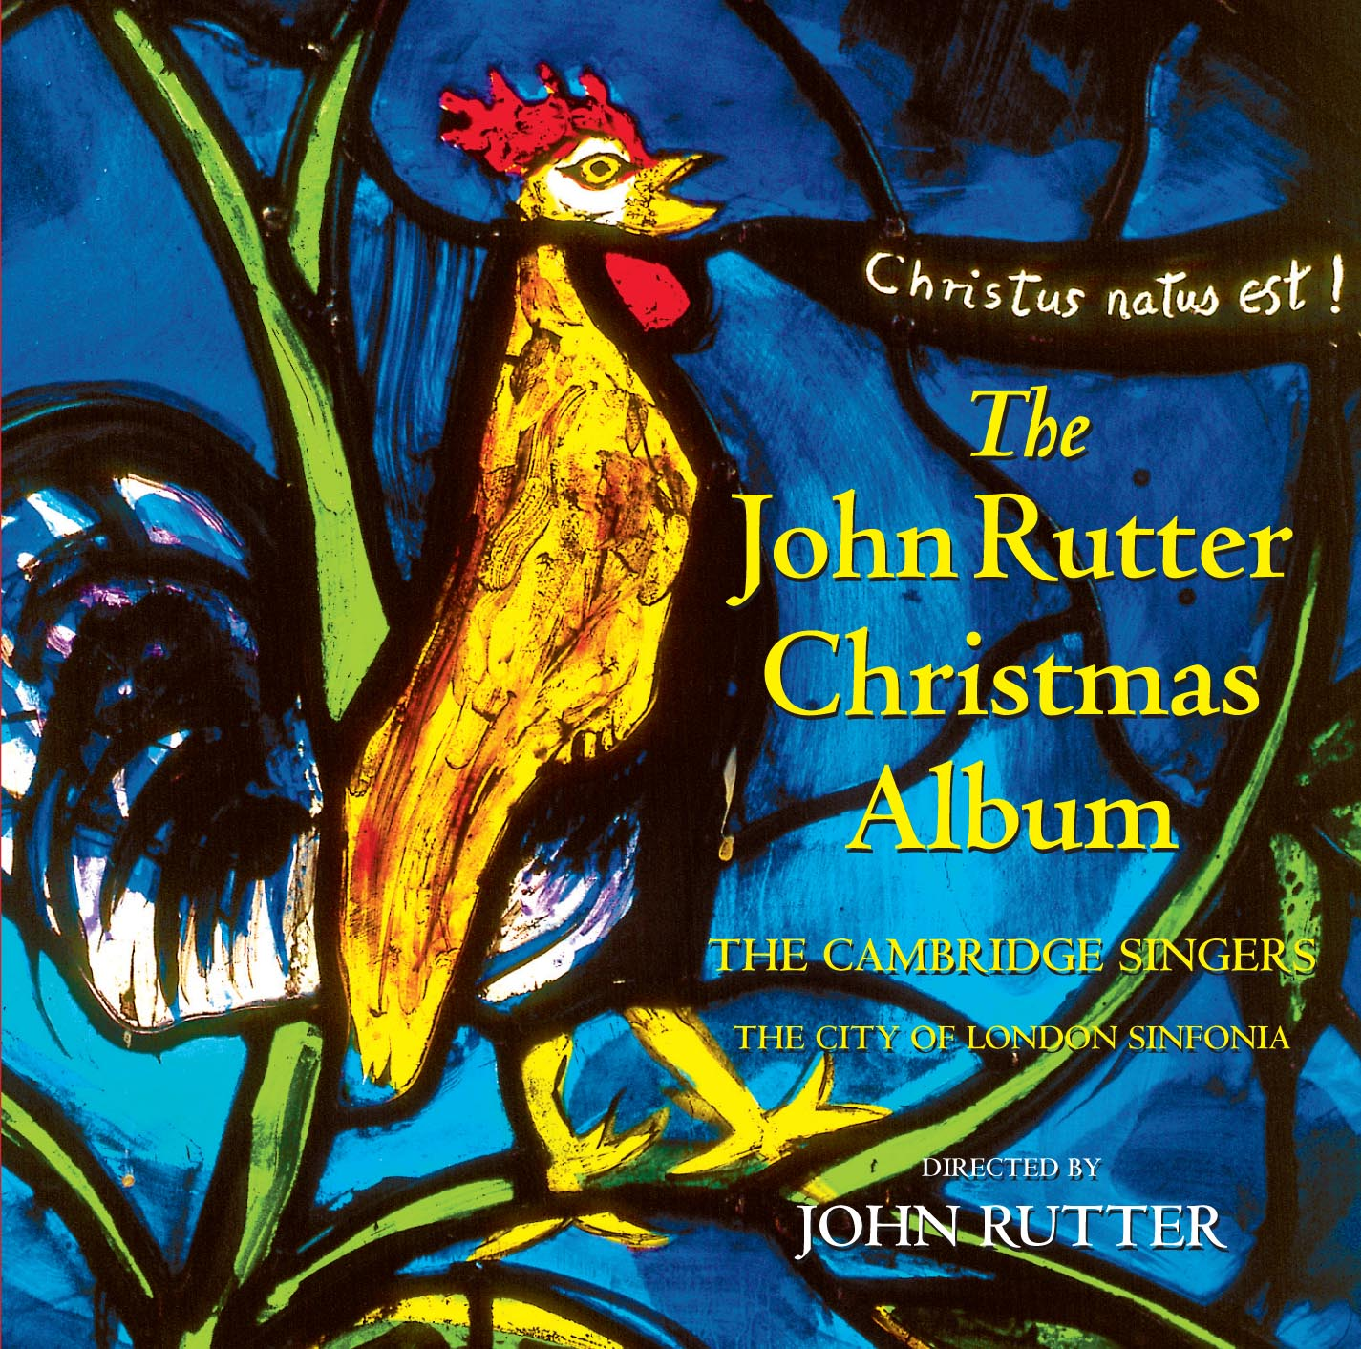
Mr Christmas!
John is most famous for his Christmas carols – choirs around the world sing his beautiful Christmas music every year.

Slide 7
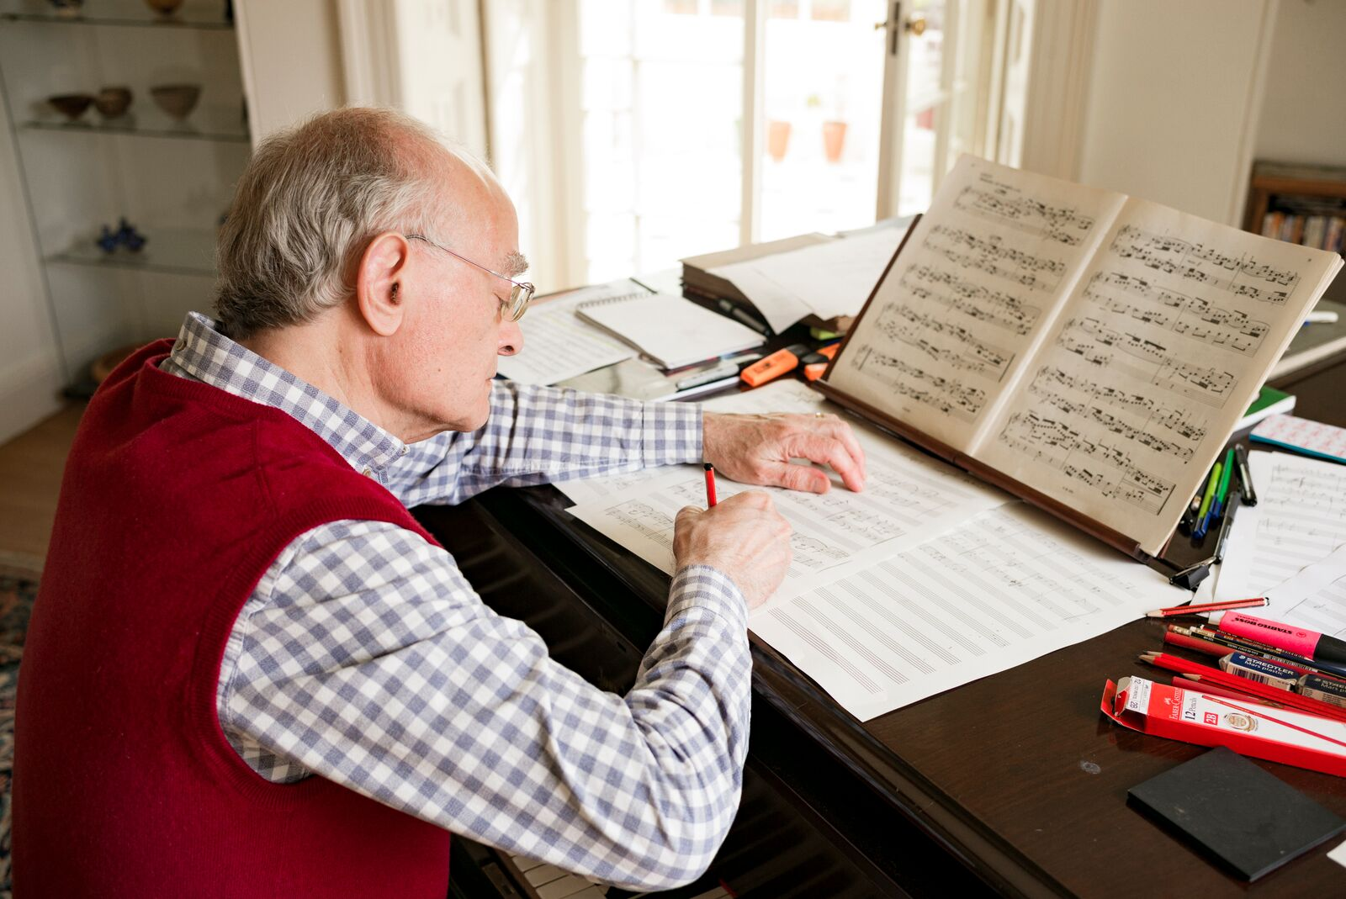
The most celebrated and successful composer of carols alive today
Sue Lawley

Slide 8
Listen to these wonderful festive pieces by John Rutter:
Star Carol - https://www.youtube.com/watch?v=9gxoGGTicNI
The Shepherd’s Pipe Carol - https://www.youtube.com/watch?v=ousLBf0q1y8
Christmas Lullaby - https://www.youtube.com/watch?v=mdWOF7u624U
Nativity Carol - https://www.youtube.com/watch?v=tq8mgyBUJgk&list=PLXpQCRhZw2lb4G6O0qZH7OV2J2FRW7PW3&index=7
Deck the Hall - https://www.youtube.com/watch?v=lB3uHEcsPZE&list=PLXpQCRhZw2lb4G6O0qZH7OV2J2FRW7PW3&index=20

