Slide 2



What is a positive learning attitude?
How can a positive learning attitude help us?
Share your thoughts with a partner and then tell the class.

Slide 3

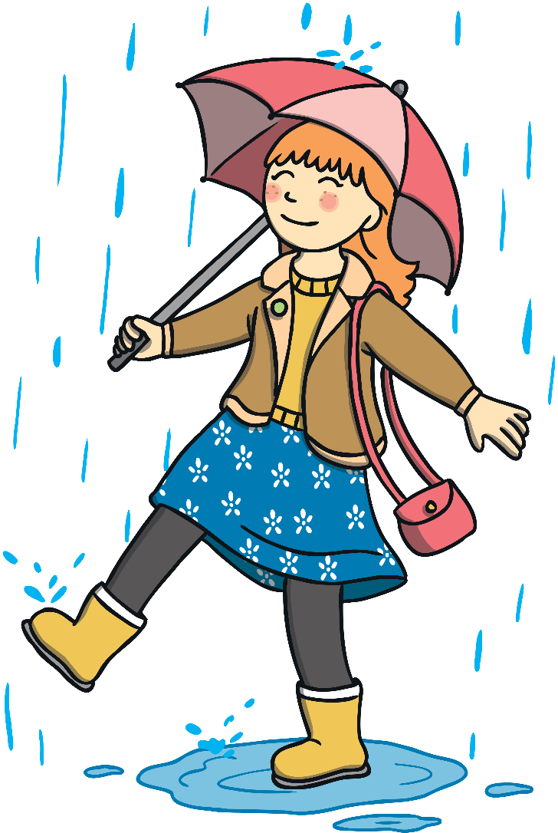
What Is a Positive
Learning Attitude?
Being positive means focussing on the good things, being hopeful and looking for ways to help things work out for the best.
Having a positive attitude doesn’t mean ignoring things that make us feel sad, worried or frightened. It just means looking for the good in all kinds of situations.

Slide 4
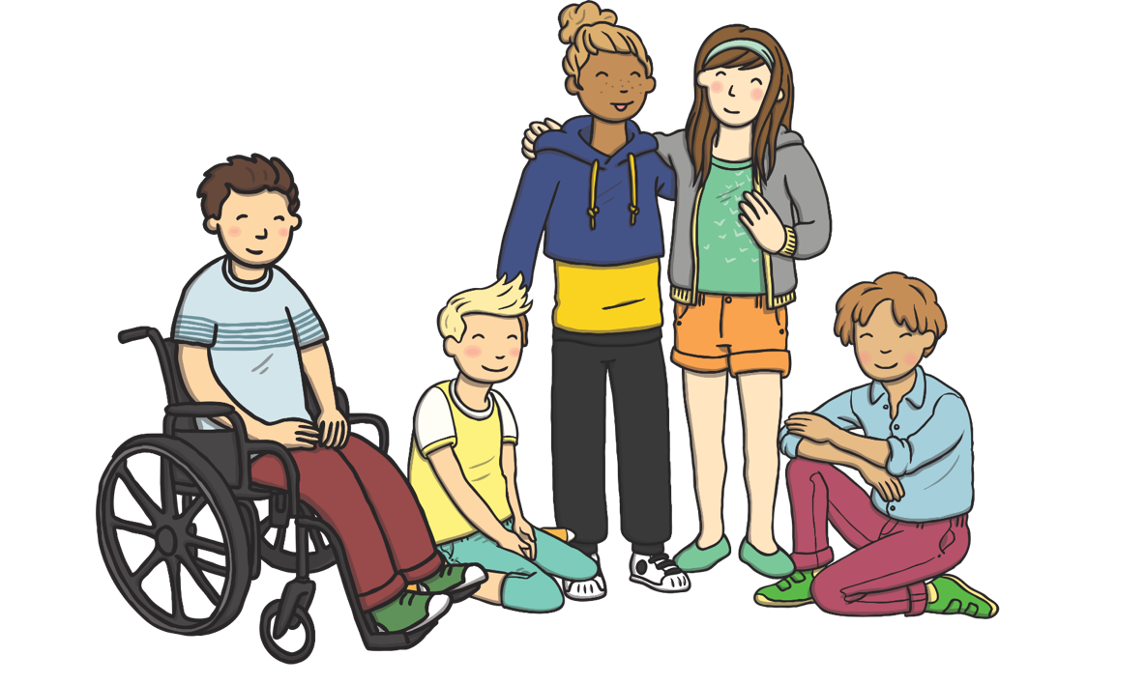
What Is a Positive
Learning Attitude?
By learning from mistakes, I can get better.
I want to try my best
with this
learning task!
This is a new challenge for me and I like learning new things!
There’s so much to learn at school. Let’s meet some friends who have a positive learning attitude and find out what they say when they are learning new things.
If I keep trying, I
will improve.
I can't do this yet, but I will!
What do you think it means to have a positive learning attitude?

Slide 5

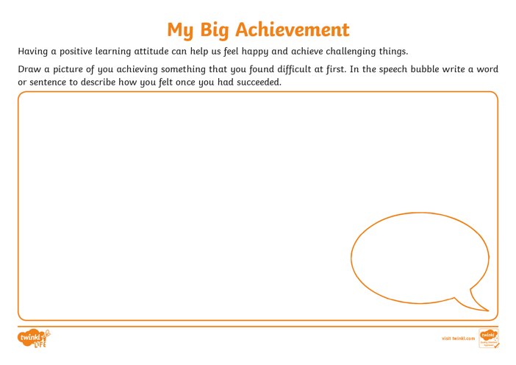


A Positive Learning Experience
Think of a time you have tried really hard to achieve a task and have done it!
Draw a picture of yourself trying and achieving this challenge and write a word or a sentence to describe how you felt once you
had succeeded.

