Slide 2

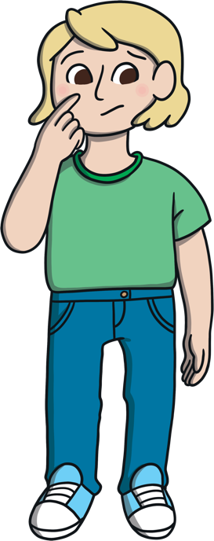
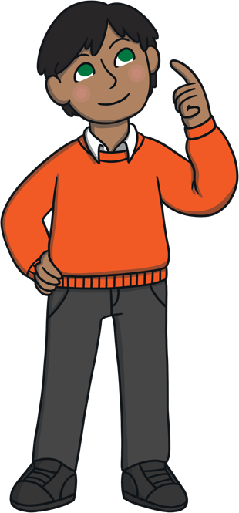
What are our
star qualities?
What star qualities would we like
to develop?
Share your thoughts with
your friends.

Slide 3


What Is a Star Quality?
We are all unique and have lots of things which make us special, things that we are good at. This is exciting!
What might our star qualities be? We might be…
strong
hard-working
loyal
generous
honest
a good listener
thoughtful
funny
careful
positive
friendly
respectful
grateful
patient
loving
fair
kind
responsible
co-operative
supportive
determined

Slide 4

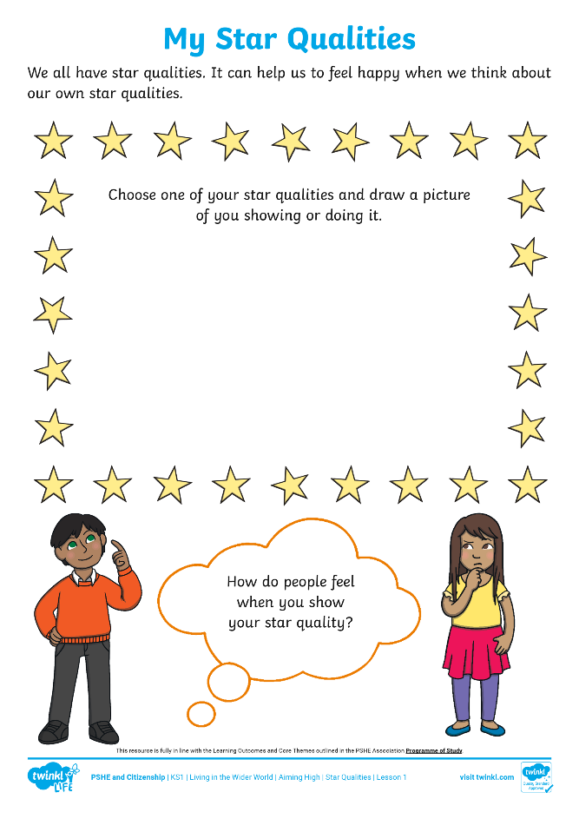
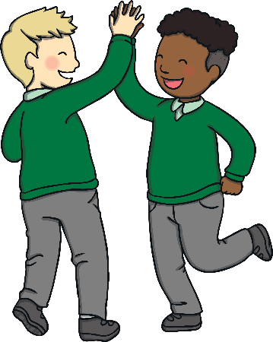

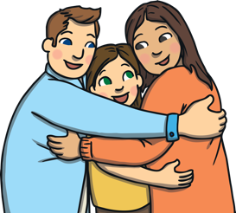

My Star Qualities
Complete the My Star Qualities Activity Sheet to show one of your
star qualities.
Draw a picture of yourself showing your chosen star quality. Think about how people feel when you show this. Write or draw your ideas in the thought bubble.

