Slide 2
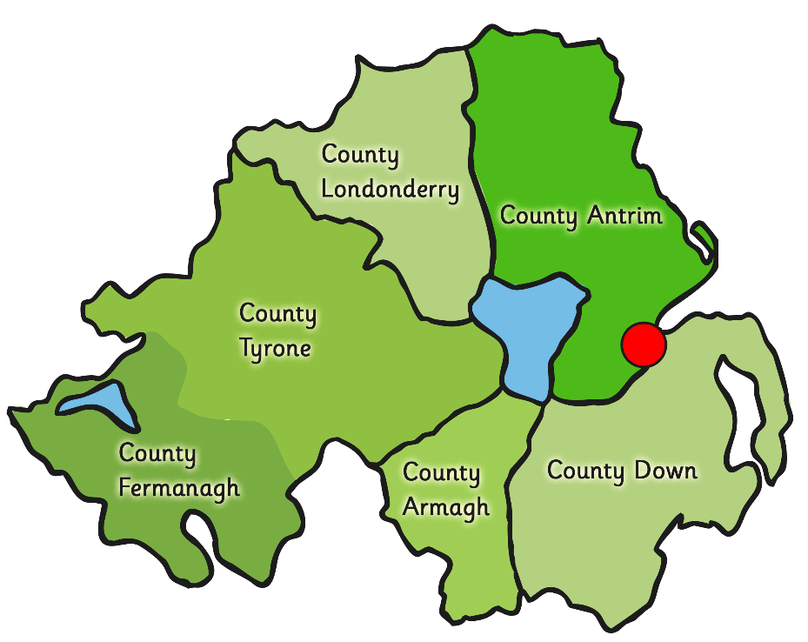
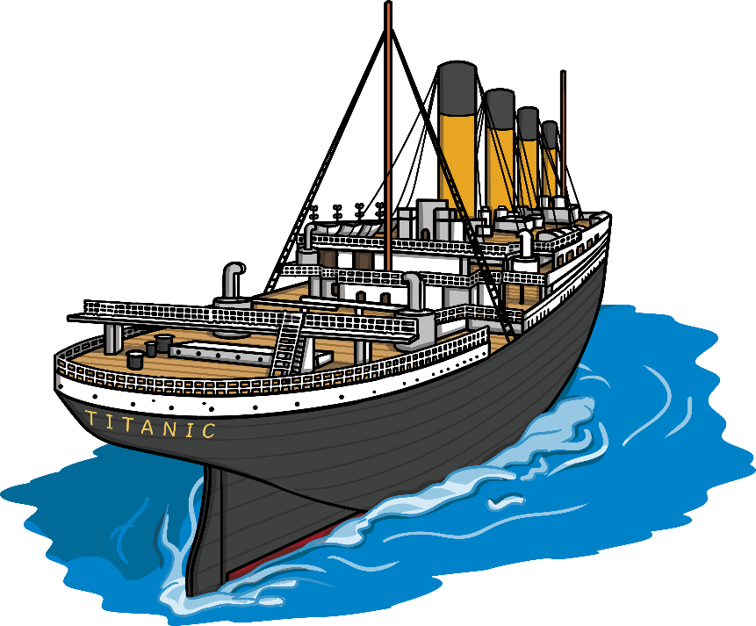
1908 -1909
Construction of the largest passenger steam ship in the world - Titanic, begins in Belfast, Ireland.

Slide 3


April 10th 1912
11:30am
Passengers arrive in Southampton excited to board the ship.
The Titanic sets off on her maiden voyage at midday.

Slide 4
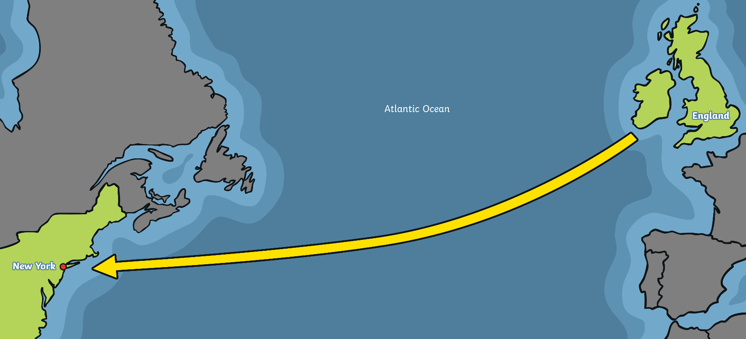
April 12th – 13th 1912
The Titanic sails through calm waters towards New York. It carries 2,223 people on board.

Slide 5

April 14th 1912
The lookouts see an iceberg dead ahead. The Titanic tries to steer round it and is hit on the right hand side.
11:40pm

Slide 6

April 14th 1912
11:50pm
Water has poured in and risen extremely quickly in the front part of the ship.

Slide 7

April 15th 1912
12:00am
The captain is told the ship can only stay afloat for a couple of hours. He gives order to call for help over the radio.

Slide 8
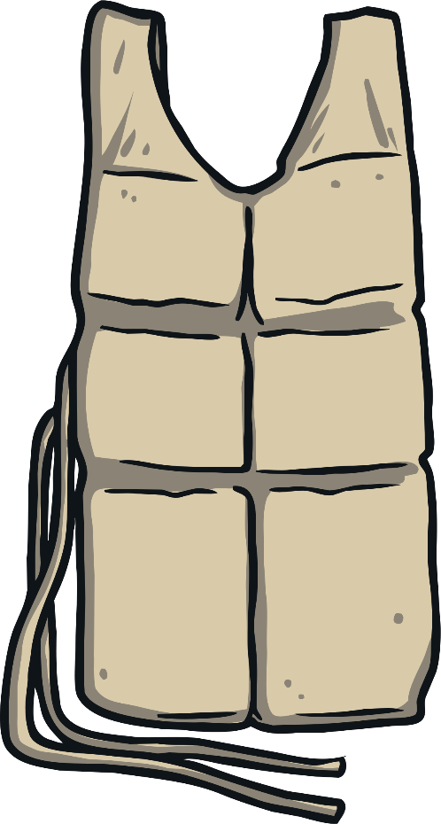
April 15th 1912
12:05am
The lifeboats are uncovered and passengers and crew get ready on deck. There is only room for half of the people on board in the lifeboats.

Slide 9
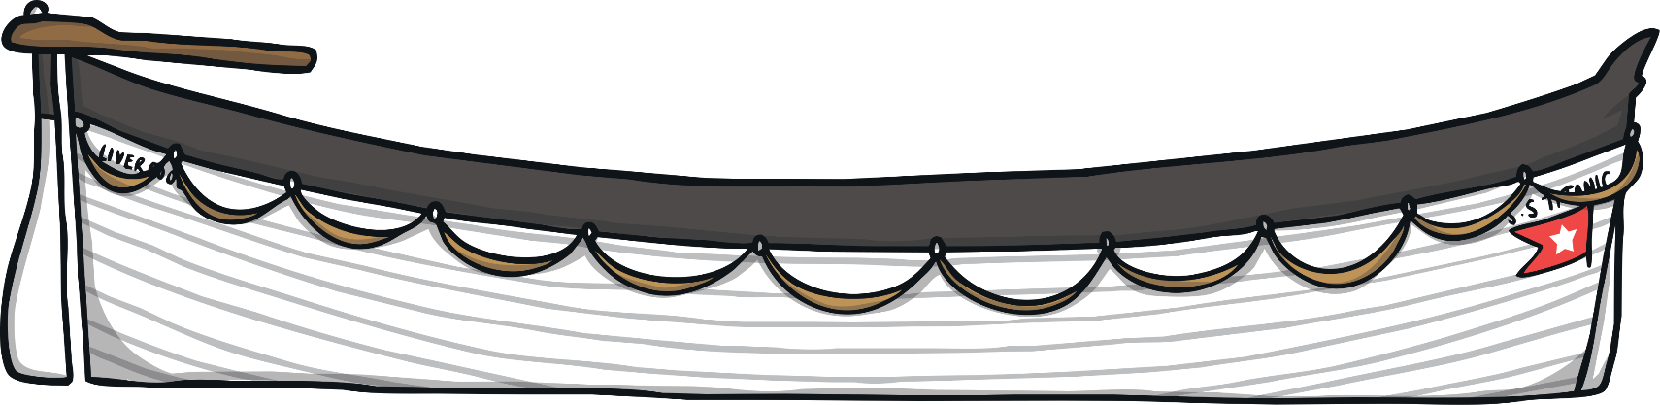
April 15th 1912
12:25am
Lifeboats are loaded with women and children first. Another ship, The Carpathia, picks up the distress call about 58 miles and sails as quickly as possible to help her.

Slide 10


April 15th 1912
12:45am
The first lifeboat lowered into the water. It leaves not even half full. The first of eight distress rockets are fired.

Slide 11


April 15th 1912
2:05am
The last lifeboat is lowered in to the water.
Over 1,500 people remain stranded on the ship. Titanic's deck becomes steeper and the rear of the ship breaks off.

Slide 12
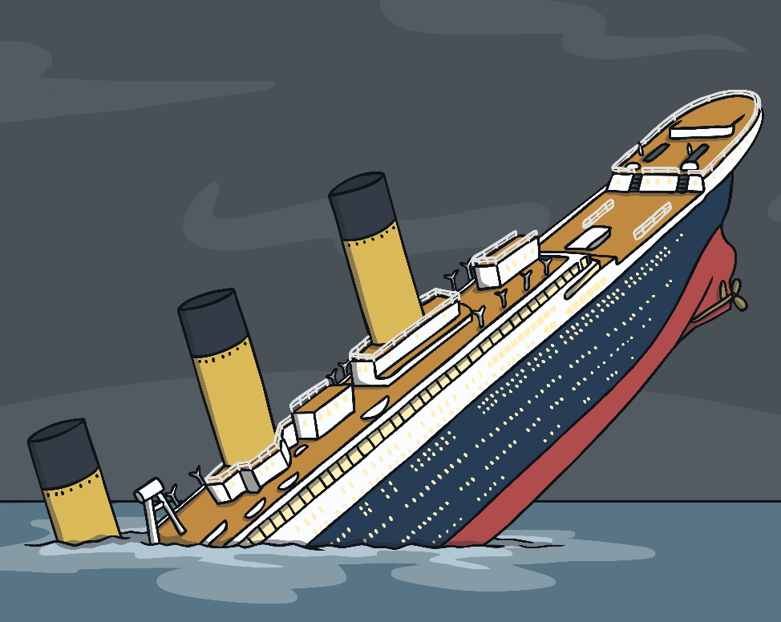
April 15th 1912
2:20am
The remaining ship levels out for a few moments before slowly filling with more water. The water pulls the ship back high into the air before pulling it under. Remaining passengers are stranded in the icy waters. Most of them are unable to be saved.

Slide 13

April 15th 1912
8:50am
The Carpathia finally travels away from any remaining wreckage and makes its way to New York.
She has managed to save only
705 passengers and crew.

