Slide 1

11+ Information for parents

Slide 2
What is the 11+
Supports attendance at Grammar and High schools
The test is not compulsory to take
Two tests which pupils sit at Year 6
The test is designed to show children who are working above National expectations and therefore are most likely to achieve well within the working environment of Grammar schools.
In Lincolnshire the 2 papers are non-verbal (including spatial reasoning) and verbal reasoning. Please do not waste time or money on resources for 11+ English or 11+ Maths.

Slide 3
Verbal Reasoning
Requires a good vocabulary and involves problems with words, sequences, codes and logic.
The best way to improve vocabulary is to read lots - preferably out loud to an adult. Pay particular attention to unknown words and ensure that your child understands the meaning of all the words - don't presume - ask. Maybe make a list of unknown words and have them look them up in a good children's dictionary/thesaurus.

Slide 4
Verbal Reasoning
Because Verbal Reasoning is not taught explicitly in school, it is important that your child becomes familiar with this type of question. They must be able to identify the question types, understand the question and have a strategy for answering them quickly.

Slide 5

Verbal Reasoning
Insert a letter that ends the first word and begins the next:

Slide 6
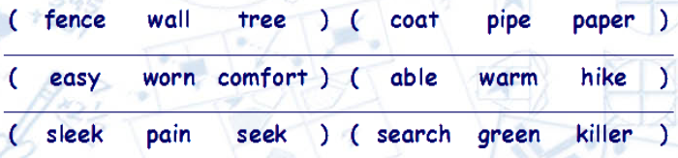
Verbal Reasoning
In the following question, find the two words, one from each group, that together make a new, real word. The word from the first group always comes first.

Slide 7
Non-Verbal Reasoning
Involves solving problems that are represented graphically with pictures and diagrams.

Slide 8
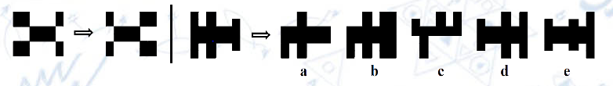
Non-Verbal Reasoning
With this type of question you are given a number of shapes separated by a vertical line.
The two shapes to the left of the vertical line demonstrate the relationship between the shapes. The shapes to the right of the vertical line can be thought of as the question and possible answers.

Slide 9
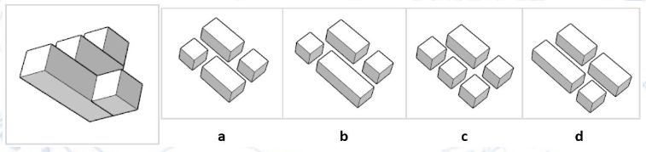
Non-Verbal Reasoning
With this type of question you are given a 3D shape on the left which is constructed
from several different sized blocks.
You are also given four options (labelled 'a' to 'd) containing sets of blocks that
could be assembled to form various 3D shapes.
You are required to select the option that contains the blocks that could be
put together to form the target image on the left.

Slide 10
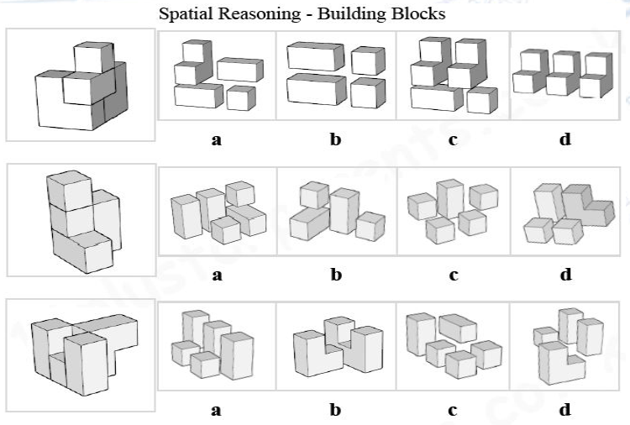

Slide 11
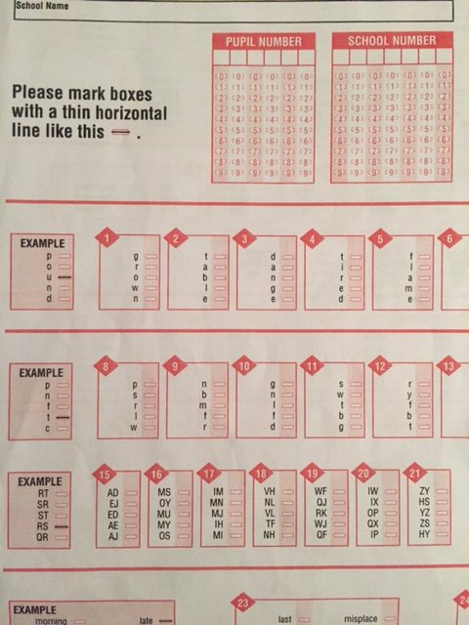
Recording
Answers

Slide 12
Supporting the children
It is not part of the National Curriculum, however activities in school support the children.
Activities in school: spelling, vocabulary, maths games, thinking skills, problem solving.
Complete practice papers at the start of Year 6.
Practise spellings and develop vocabulary work at home
Resources and practice at home
Practise under timed conditions

Slide 13
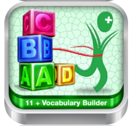
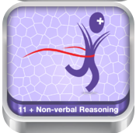
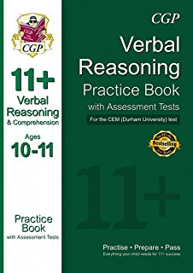
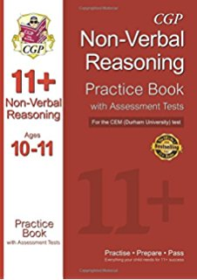
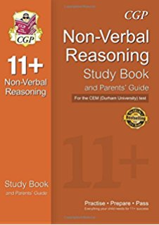
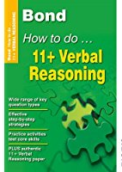
Resources
http://www.11plusforparents.co.uk/index.html

Slide 14
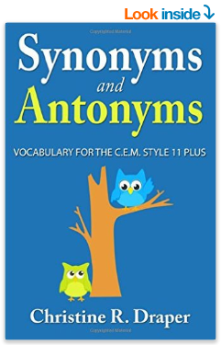
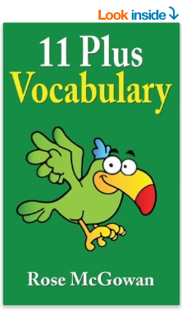
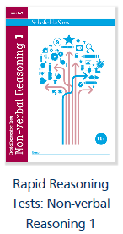
Resources
Schofield &
Simms

Slide 15
Information
The test is not compulsory to take
You will be asked to register for your child to sit the test – you need to do this as we do not automatically register the children
Catch-up tests normally take place at the High School or Grammar School
Test is normally administered within the first three weeks of September when your child is in Year Six
Results are sent home – Lincolnshire pass or selective pass

Slide 16
11+ Information for parents

