Slide 2



Diving into Mastery Guidance for Educators
Each activity sheet is split into three sections, diving, deeper and deepest, which are represented by the following icons:
These carefully designed activities take your children through a learning journey, initially ensuring they are fluent with the key concept being taught; then applying this to a range of reasoning and problem-solving activities.
These sheets might not necessarily be used in a linear way. Some children might begin at the ‘Deeper’ section and in fact, others may ‘dive straight in’ to the ‘Deepest’ section if they have already mastered the skill and are applying this to show their depth of understanding.
Diving
Deeper
Deepest

Slide 3
Aim
Multiply numbers up to 4 digits by a one- or two-digit number using a formal written method, including long multiplication for two-digit numbers.

Slide 4
Multiply 4 Digits by 1 Digit
Diving
Thousands | Hundreds | Tens | Ones
Write the multiplication calculation which is represented by the place value counters.
 | 1 | 2 | 3 | 1
× |  |  |  | 3
 | 3 | 6 | 9 | 3

Slide 5
Multiply 4 Digits by 1 Digit
Diving
Thousands | Hundreds | Tens | Ones
Write the multiplication calculation which is represented by the place value counters.
 | 2 | 3 | 2 | 2
× |  |  |  | 4
 | 9 | 2 | 8 | 8
 | ¹

Slide 6
Multiply 4 Digits by 1 Digit
Diving
Thousands | Hundreds | Tens | Ones
Write the multiplication calculation which is represented by the place value counters.
 | 5 | 0 | 4 | 2
× |  |  |  | 6
3 | 0 | 2 | 5 | 2
 |  | ² | ¹

Slide 7

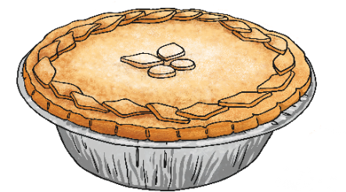
Multiply 4 Digits by 1 Digit
Diving
Thousands | Hundreds | Tens | Ones
Write a word problem which
could be solved by the calculation represented by the place value counters.
The place value counters show 3105 × 3.
Here is one possible word problem:
Jasmine packs 3105 pies a day.
How many pies does she pack after 3 days?

Slide 8


Multiply 4 Digits by 1 Digit
Deeper
Can you identify the errors that have been made in these short multiplication calculations?
Carry out the calculations correctly to find the correct products.
The correct answer is
14 586.
1 × 6 has been recorded as 1 whereas it is in fact 6.
 | 2 | 4 | 3 | 1
× |  |  |  | 6
1 | 4 | 5 | 8 | 1
 | ² | ¹
 | 3 | 4 | 1 | 5
× |  |  |  | 3
1 | 0 | 2 | 3 | 5
 | ¹
The correct answer is
10 245.
The regrouped ten has not been added to the 3 lots of tens to make 4 tens.

Slide 9

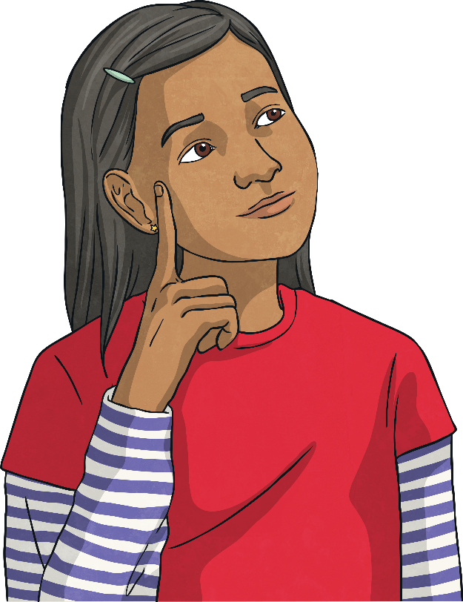
Multiply 4 Digits by 1 Digit
Deepest
Can you identify the missing digits in these calculations?
 |  | 3 |  | 1 | 4
 | × |  |  |  | 3
 |  |  | 6 |  | 2
 |  |  |  | 2 | 4
 | × |  |  |  | 5
 | 2 | 5 | 1 |  | 0
2
9
4
¹
5
0
2
¹
²

Slide 10


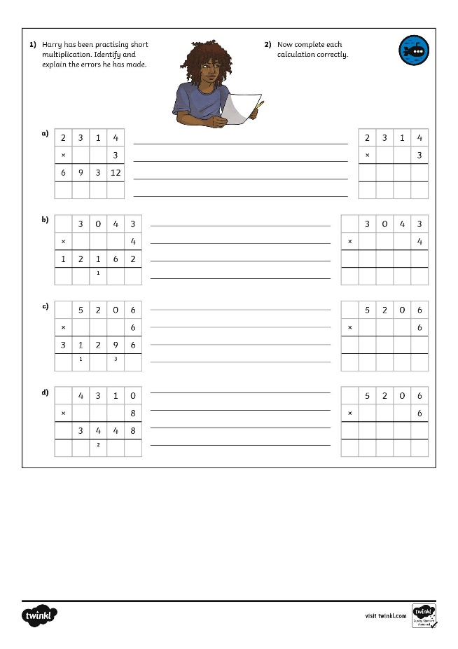
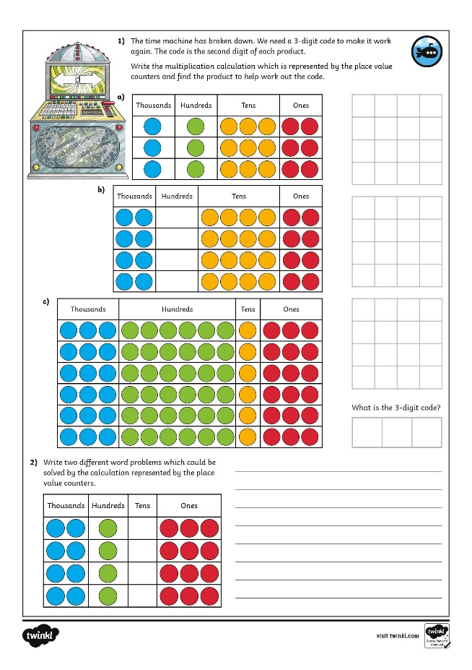
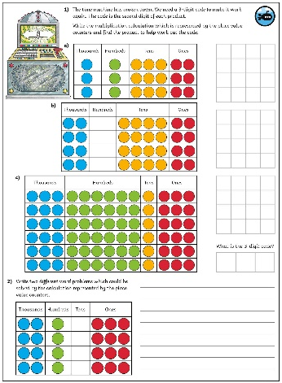
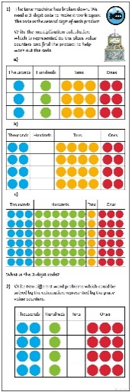
Multiply 4 Digits by 1 Digit
Dive in by completing your own activity!

Slide 11
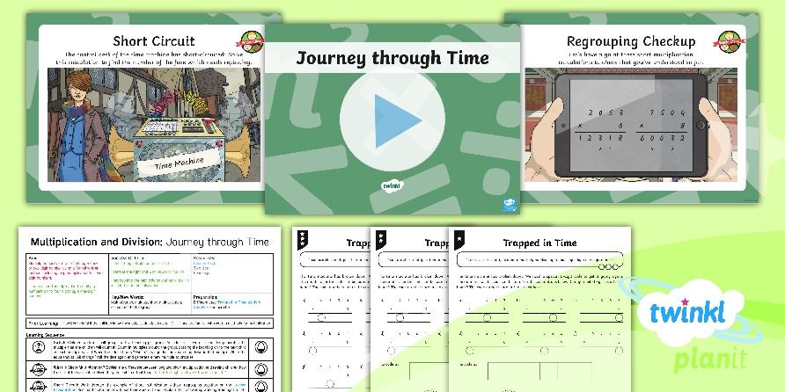
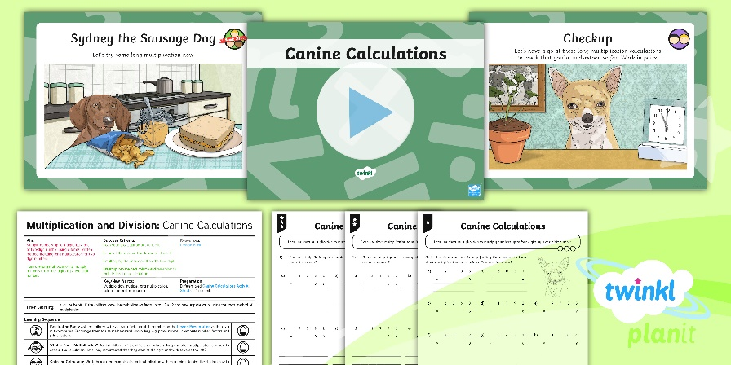

Need Planning to Complement this Resource?
National Curriculum Aim
Multiply numbers up to 4 digits by a one- or two-digit number using a formal written method, including long multiplication for two-digit numbers.
For more planning resources to support this aim, click here.
Twinkl PlanIt is our award-winning scheme of work
with over 4000 resources.

