Slide 2
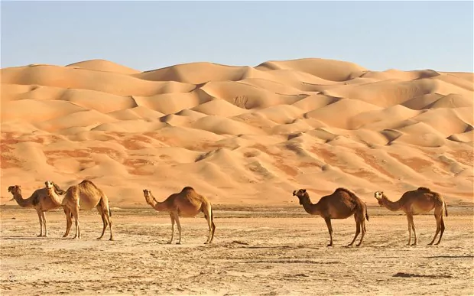

Slide 3
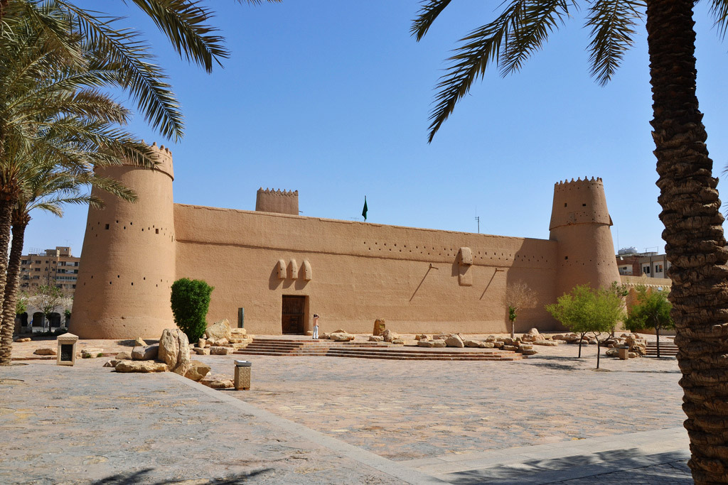
Old Saudi Arabia

Slide 4
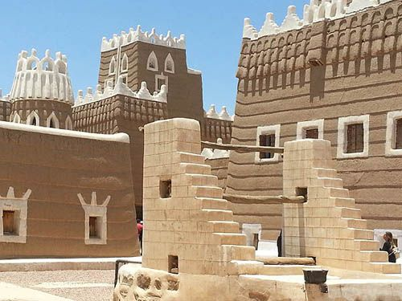
Old Saudi Arabia

Slide 5
How is Saudi Arabia different to the UK?

Slide 6
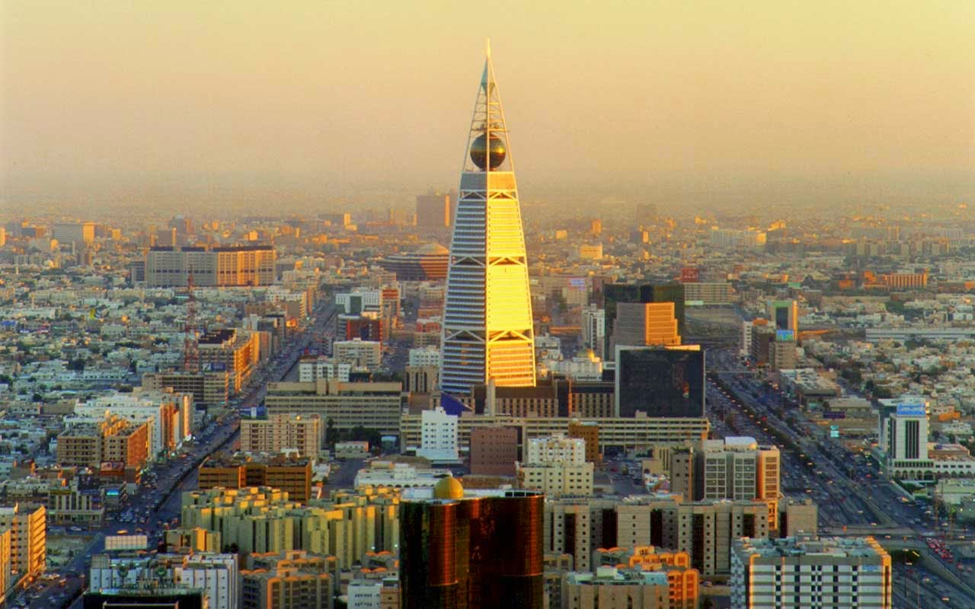
Modern Saudi Arabia

